Slide 1
Widening Access to HE for adult learners in Wales.
Gayle Hudson – Widening Access Manager

Slide 2

Over 25% of our students live in the most deprived areas in Wales.
Approx 17% of our students have disabilities.

Slide 3
Political context in Wales
Widening Access and social justice are priorities for the Welsh Government
Regional HE structures and partnership work
Increasing focus on school standards and young people’s aspiration
Adult learning funding slashed across Wales
Hundreds of community courses being withdrawn

Slide 4
Widening Access priority groups in Wales
Higher Education Funding Council in Wales (HEFCW) widening access priority groups are:
        Communities First residents
        Those living in the bottom IMD quintile in Wales
Sector target = 22.4% of student population by 15/16
They also closely monitor the participation of other under-represented groups including;
        low HE participation neighbourhoods
        workless households
        disabled people
        carers
        those with a care background
        ex-offenders

Slide 5
Making connections / reaching learners
Learners
Community Learning & info providers
Employers and trades unions
Notes:
Ou works at scale, doesn’t have the local connections that local brick universities have. We work closely with trusted intermediaries to reach learners.

Slide 6
Reaching WA students
Through national and local partnerships
Working closely with other formal and informal education providers, trades unions and employers.
Local events in targeted areas
Partnership with libraries across Wales – regular OU drop in sessions
Reaching Wider Partnership Projects
Step into STEM – family learning
Summer University
OU Access project
Underpinned by Wales’ specific WA marketing campaigns

Slide 7

Using OER to prepare for study

Slide 8
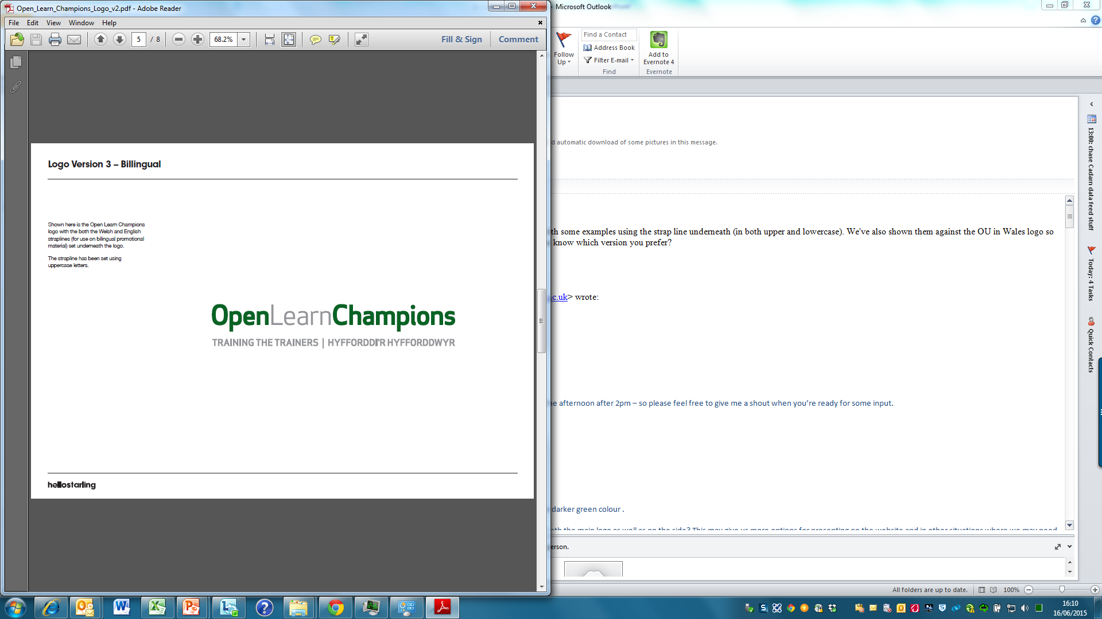
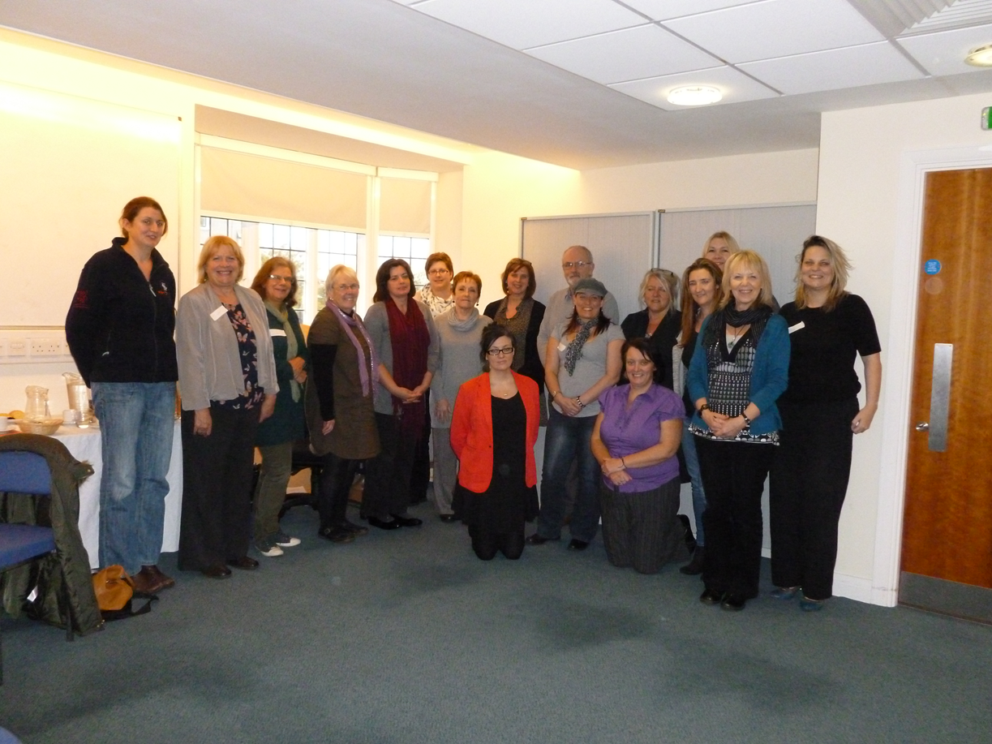

Slide 9

Pathways to Success
Tailored pathways through OpenLearn in;
Health and Social Care
Maths and Science
Social Science
Arts and Humanities

Slide 10
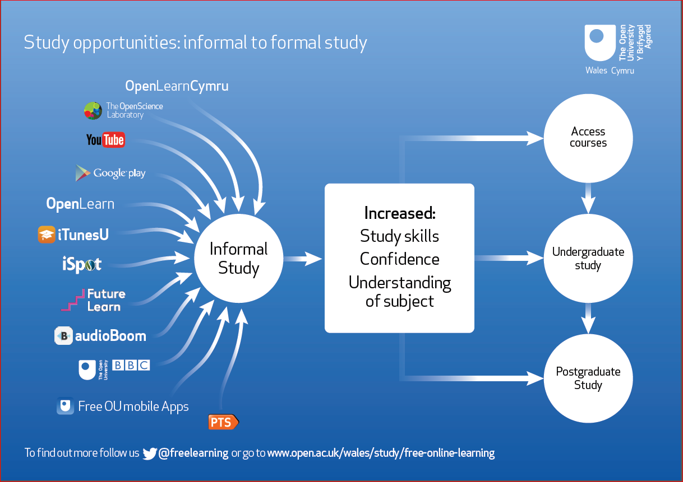
Notes:
JIFL….UNMASK REST OF SCREEN

Slide 11
Students’ success
Working closely with the registration and learner support team in Wales to offer information advice and guidance
On course pro-active support from Student Support Teams
Specific interventions in Wales e.g for disabled students

Slide 12


OU in Wales WA dilemma
Local v Scale
Where do we meet students on their
learning journey?
Notes:
Local V scale – presence on the ground
Are we targeting the right partners?
Are we starting where the learners are?
WA recruitment V support & retention
Should we do more through partnership work to prepare WA groups for HE study?

Slide 13
Gayle.hudson@open.ac.uk
Widening Access Manager

