Slide 1
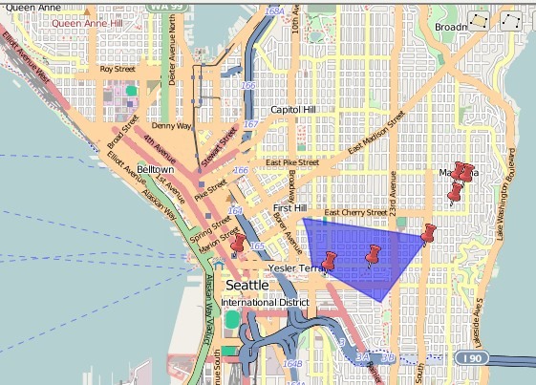
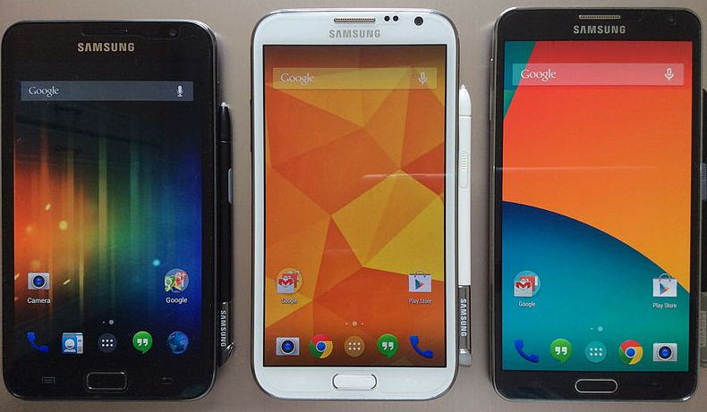
Working the cracks: Poverty politics and the digital
Sarah Elwood
University of Washington

Slide 2
Digital mediations of poverty:
“Anti-poverty apps”
Live-streamed, social-media linked conspicuous philanthropy (e.g. microfinance lending websites, map interfaces, data streams)
Digital sharing economy and a new ‘precariat class’
e.g. TaskRabbit, Uber, Lyft, etc.

Slide 3
How and with what effects does pervasive mobile digitality intersect with diverse development geographies?
(How) Can digital practices offer openings for counter-hegemonic poverty politics?
How can we disrupt normative ‘common sense’ around poverty, can digital practice be part of this?

Slide 4
Digitality itself matters
Mobile, (social) networked, hyperlinked, spatial technologies are forms of digitality that simultaneously enclose and resist enclosure
Tendency to both re-iterate existing social/spatial inequalities and provide generative grounds for new practices, politics

Slide 5
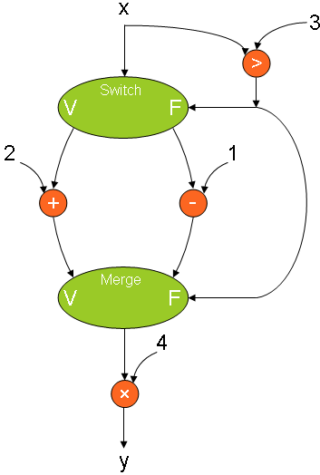
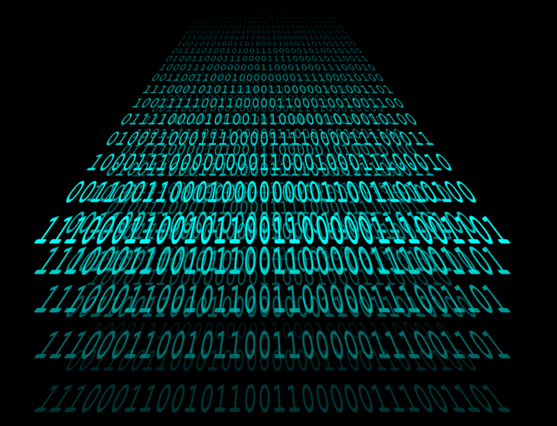
Digital closures
Digitality rooted in numerical representation
Numeracy→automation, algorithmic control,

Slide 6
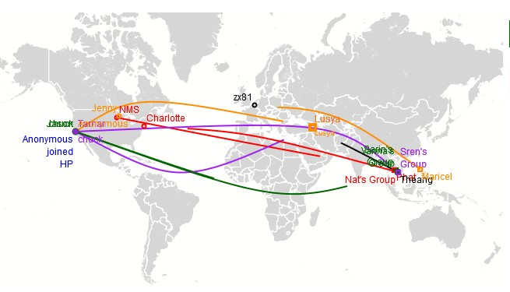

Slide 7
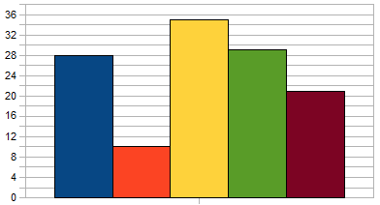
“Lending Teams:
Connect with Kiva’s lender community”
Team Leaderboards: *Amount loaned
*New members
*New loans
“…rally around shared lending goals by counting each of your loans at checkout toward the team's impact.”
(http://www.kiva.org/teams)

Slide 8
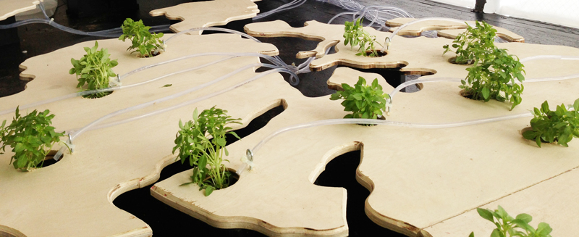
Digital openings
Digitality also relies on modularity & variability
Openings for poly-vocality, for reworking toward counter-hegemonic practices, politics

Slide 9
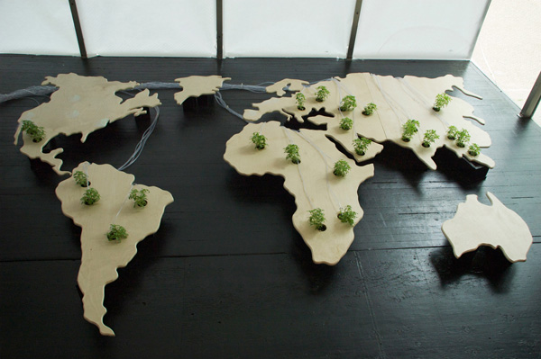
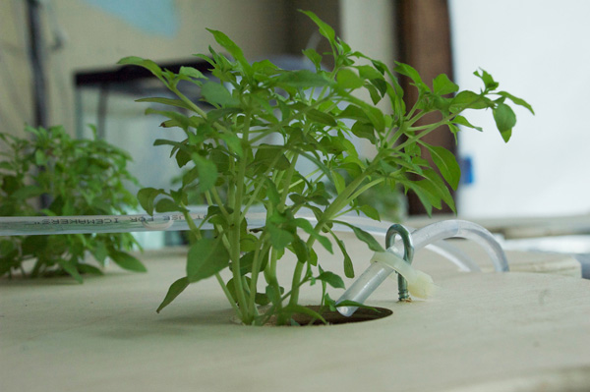

Slide 10
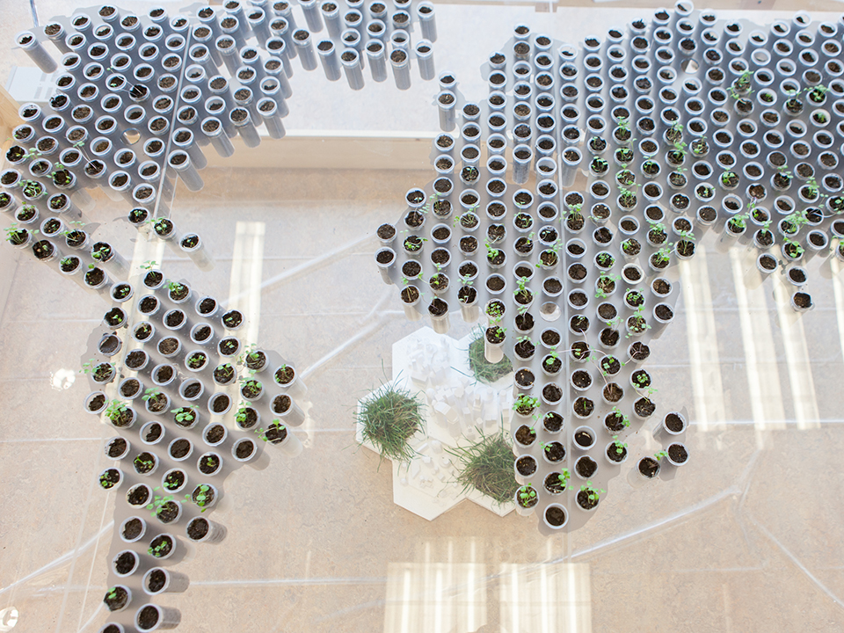
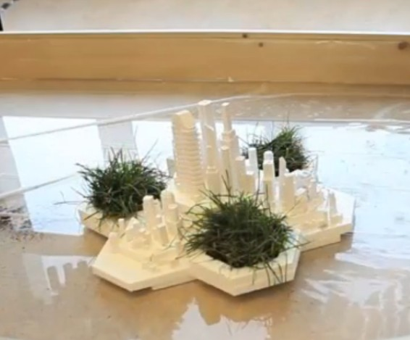

Slide 12
Engaging the ambiguities of the digital
“…the process of collective creativity associated with working the cracks…the forms of good sense that provide generative flashpoints of hope” (Gibson 2014).
How can creative digital practice move forward in the face of ambiguities? Where are the cracks & how do we work them?

