Slide 1
From a single line of code to an entire city
Rob Kitchin
NIRSA, National University of Ireland Maynooth

Slide 2
Software and the city
‘The modern city exists as a haze of software instructions. Nearly every urban practice is becoming mediated by code’ (Amin and Thrift 2002: 125)
Software has become essential to the functioning of cities
It is deeply and pervasively embedded into the systems and infrastructure of the built environment and in the management and governance of urban societies
Software is used to produce, mediate, augment, and regulate systems and tasks producing what has been termed ‘smart cities’

Slide 3
State of play
Most studies focus on the production of software from a technical & organisational perspective
A small proportion take a more critical perspective, but largely focus on the socio-spatial practices and effects of software on urban systems and life
Only a handful of cases focus on the nature of software itself
The principle argument of the latter is that:
code is produced, shaped by diverse forces
code is an actant that possesses ‘secondary agency’ ― power to make automated, automatic and autonomous decisions and action
code transduces space ― code/space
the city becomes programmable, that is open to recoding and remediation, but also to being buggy, brittle and hackable

Slide 4
State of play
Social scientists and humanities scholars are struggling to get to grips with a series of interrelated phenomena ― code, ubiquitous computing, big data, networked urbanism, and smart cities
Code/Space: Software and Everyday Life (2011) was an attempt to provide an overarching, holistic conceptual framework to make sense of the changes digital technologies were making to the urban condition
It was provisional ― a staging post rather than definitive guide
Want to revisit some of the conceptual ideas developed in Code/Space and rework and extend them

Slide 5
Thinking about code and the city
In Code/Space we argued that software needed to be understood as being both a product of the world and a producer of the world
Software is not an immaterial, stable, value-free product, it is a complex, multifaceted, mutable set of relations created through diverse sets of discursive, economic and material practices rooted in particular locales
Software does not simply represent the world, but actively participates in it, transducing space, reshaping work, transforming practices, and so on
We thus argued for the need to delve further into the nature of code itself and examine the work that code does in the world
With respect to the first, we advocated a very software studies approach to making sense of code and cities; a focus on the code itself

Slide 6
Thinking about code and the city
I am still of the view that an in-depth focus on code and coding would be an enormously profitable endeavour
Kitchin, R. (2014) Thinking critically about and researching algorithms. The Programmable City Working Paper 5 SSRN http://ssrn.com/abstract=2515786
Examining pseudo-code/source code
Reflexively producing code
Reverse engineering
Interviewing designers or conducting an ethnography of a coding team
Unpacking the socio-technical assemblage of algorithms
Examining how algorithms do work in the world

Slide 7
Thinking about code and the city
However, it potentially adopts an analytical lens that over-fetishizes and potential decontextualises code at the expense of its wider assemblage of production and use
The relationship between code and the city is complex and diverse
Code/software are critical to networked urbanism, but so too are data, platforms, hardware, interfaces, and users
And none of these can be fully understood without being considered in relation to one another, nor outside of their wider context
Data assemblage: just as data are a product of the assemblage, the assemblage is structured and managed to produce those data

Slide 8
Data Assemblage
Attributes | Elements
Systems of thought | Modes of thinking, philosophies, theories, models, ideologies, rationalities, etc.
Forms of knowledge | Research texts, manuals, magazines, websites, experience, word of mouth, chat forums, etc.
Finance | Business models, investment, venture capital, grants, philanthropy, profit, etc.
Political economy | Policy, tax regimes, public and political opinion, ethical considerations, etc.
Govern-mentalities / Legalities | Data standards, file formats, system requirements, protocols, regulations, laws, licensing, intellectual property regimes, etc.
Materialities & infrastructures | Paper/pens, computers, digital devices, sensors, scanners, databases, networks, servers, etc.
Practices | Techniques, ways of doing, learned behaviours, scientific conventions, etc.
Organisations & institutions | Archives, corporations, consultants, manufacturers, retailers, government agencies, universities, conferences, clubs and societies, committees and boards, communities of practice, etc.
Subjectivities & communities | Of data producers, curators, managers, analysts, scientists, politicians, users, citizens, etc.
Places | Labs, offices, field sites, data centres, server farms, business parks, etc, and their agglomerations
Marketplace | For data, its derivatives (e.g., text, tables, graphs, maps), analysts, analytic software, interpretations, etc.

Slide 9
Digital technology stack
Reception/operation
Reception/Operation
Interface
Interface
Interface
Data
Interface
Software
Form/Function
Algorithms
Data(base)
Data(base)
Code
Protocols
Software
Code platform
Platform
Defaults
Hardware
Material Platform
Bogost and Montfort (no date)
Van Dijck (2013)
White (2014)
Kitchin (2014)
Prioritising code, at the expense of the rest of the stack, places a constraint on developing a holistic, socio-technical understanding of how a digital technology is conceived and works in practice

Slide 10
Digital socio-technical assemblage
Critical Social Science
Science Technology Studies
System/process
performs a task
Context
frames the system/task
New media studies
game studies
Reception/Operation (user/usage
Systems of thought
Forms of knowledge
HCI, remediation studies
Interface
Finance
Critical code studies
Software studies
Code/algorithms
(software)
Political economies
Critical data studies
Data(base)
Governmentalities & legalities
Code Platform
(operating system)
Organisations and institutions
Platform studies
Subjectivities and communities
Material Platform
(infrastructure – hardware)
Marketplace

Slide 11
From assemblages to city
Unpacking a digital socio-technical assemblage is no easy task, but it is manageable as a large case study if focused on a single assemblage such as an program/app/system
The city, however, consists of millions of interconnected socio-technical assemblages, working in concert and contest to transduce the urban condition
A key question then is how to make sense of this dense, interconnected web of assemblages that are constantly working in dynamic flux?

Slide 12
Thinking about code and the city
The problem with examining in detail individual socio-technical assemblages is that the city largely disappears from view
Certain elements get examined, but in isolation, meaning that a more holistic understanding of how various systems combine and interact to produce the whole is never formulated
Clearly cities are large, complex, multifaceted, open systems and it is all but impossible to fully comprehend all their interlocking systems
Nevertheless, it should be possible to map out the ways in which socio-technical assemblages (mis)align, work together, compete, coalesce to form larger assemblages, and so on
Such mapping would usefully illustrate how networked urbanism is being built and functions in practice

Slide 13
Thinking about code and the city
However, urban studies discusses the effects of digital socio-technical assemblages, but rarely unpacks the constitution and mechanics of those assemblages
For example, a paper might discuss
anticipatory governance and its effects on civil liberties,
or the security vulnerabilities of the internet of things and its consequences with respect to privacy,
without explicating the specific ways in which systems are configured, code and algorithms work, data are parsed and analyzed, users interface, engage, resist, and so on
Adopts a viewpoint that examines effects rather than the causes

Slide 14
A more holistic approach?
We have a major disconnect occurring in the literature
Science and technology scholars are focused on the nature of specific elements of socio-technical systems.
Urban scholars are focused on the embedding of digital technologies into urban environments and their social, political and economic effects
Occasionally these perspectives meet, but largely remain apart
A key question then is how to marry them into a conceptual whole, or at least place them in productive tension
The solution seems to be to scale the socio-technical perspective up, and drill the urban studies focus down so that they overlap in view and epistemology

Slide 15
Programmable urbanism
Need a conceptual framework for understanding what I term ‘programmable urbanism’
The instrumented, mutable form of smart cities - that scales between individual socio-technical assemblages and their components to the city and their dense interconnection and embedding within a wider discursive, political and economic landscape
The framework should simultaneously unpack socio-technical assemblages and chart their interconnections and interdependencies and how they scale to frame and create city life

Slide 16
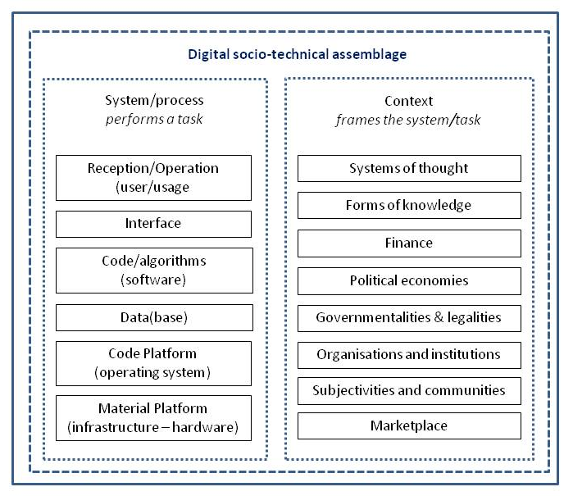
Smart Cities
Wider discursive, political and economic landscape
Political economies
Governmentalities & legalities
Finance
Organisations and institutions
Marketplace
Subjectivities and communities
Systems of thought
Forms of knowledge
Diverse, interconnected socio-technical assemblages
Constantly contested and evolving over time

Slide 17
Programmable urbanism
Need a conceptual framework for understanding what I term ‘programmable urbanism’ -- the instrumented, mutable form of smart cities -- that scales between individual socio-technical assemblages and their components to the city and their dense interconnection and embedding within a wider discursive, political and economic landscape
The framework should simultaneously unpack socio-technical assemblages and chart their interconnections and interdependencies and how they scale to frame and create city life
Enacting this framework through empirical study would be an arduous task for an individual, but it is certainly not beyond the bounds of a research team or network of collaborators

Slide 18
Conclusion
A smart city is not a vision of a future city; it already exists in practice through the millions of interconnected, digital socio-technical assemblages embedded into the fabric of cities that frame how people travel, communicate, manage, play, consume, work, and so on
The challenge for critical scholars is to make sense of the relationship between digital assemblages and the city
To date, studies have remained quite divided and have shortcomings
Studies that focus on code are narrow in remit, fading out the city, and tend to fetishize code at the expense of the wider socio-technical assemblage within which it is embedded
Studies that focus on the city tend to examine the effects of code but rarely unpack the constitution and mechanics of the code producing those effects
We need to find a way to intertwine such perspectives

Slide 19
Conclusion
I have forwarded two interlinked conceptual frameworks
The first places code within a wider socio-technical assemblage
The second conceives the city as being composed of millions of such assemblages
The latter seeks to provide an understanding of programmable urbanism that scales from individual lines of code to the complexity of an entire urban system
It is certainly not comprehensive in scope or captures the complex processes and interdependencies at play
But it does provide an initial scaffold for seeking to scale software studies up towards the city and to drill urban studies down towards code

Slide 20
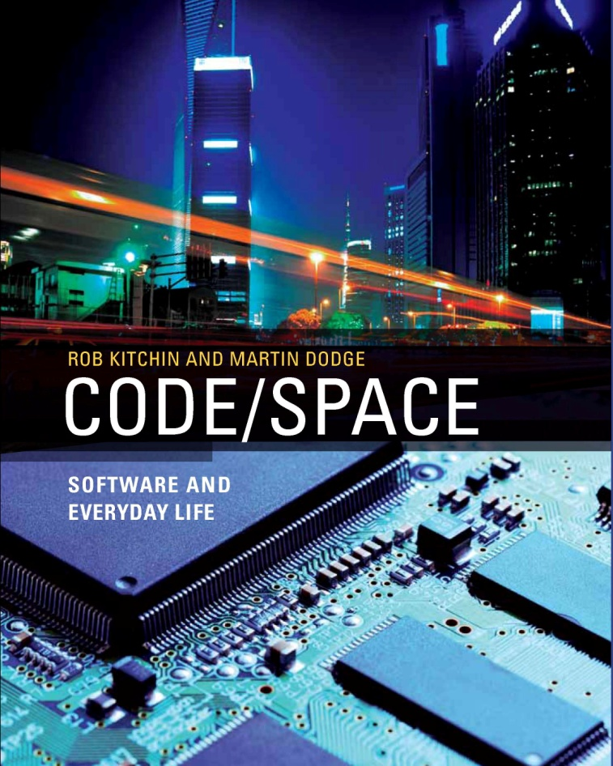
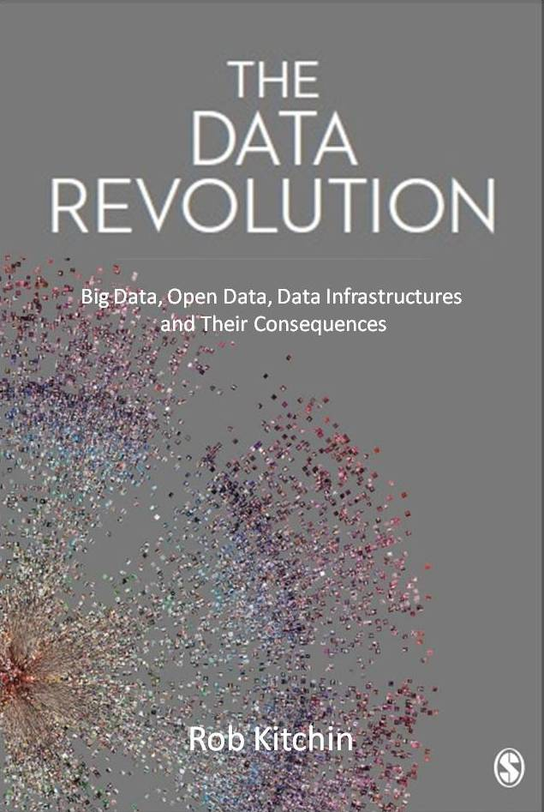
Rob.Kitchin@nuim.ie
@robkitchin
http://www.nuim.ie/progcity
@progcity
Kitchin, R. (2014) From a single line of code to an entire city: Reframing thinking on code and the city. The Programmable City Working Paper 4. SSRN http://ssrn.com/abstract=2520435

