Slide 1
Geographies of, produced by, and produced through, the digital
Rob Kitchin
NIRSA, National University of Ireland Maynooth

Slide 2
Introduction
Short concept note
Want to consider in brief:
  the relationship between the digital and geography
  to what extent is it useful to delimit digital geography as a defined field of research?

Slide 3
Geographies of the digital
Applying geographical ideas and methodologies to make sense of the digital
Focuses on mapping out the geographies of digital technologies, their associated socio-technical assemblages and production.
  mapping of cyberspace
  charting the spatialities of social media and games
  plotting the material geographies of ubiquitous computing
  detailing the economic geographies of component resources, technologies and infrastructures
  tracing the generation and flows of big data

Slide 4
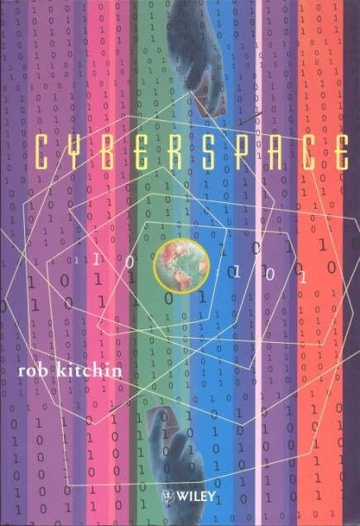
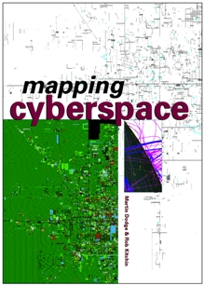
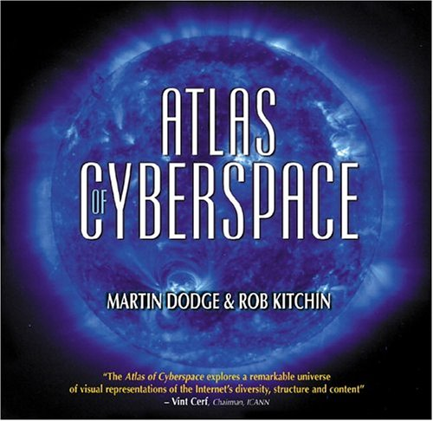
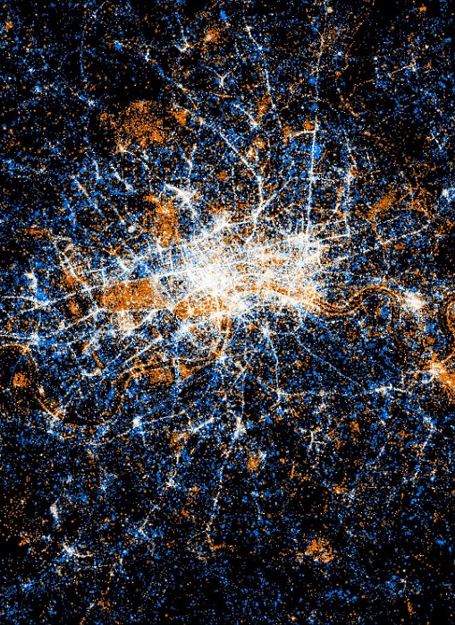
Geographies of the digital

Slide 5

Geographies produced by the digital
Applying critical social science, science and technology studies, geographical thinking to examine how the digital is mediating and augmenting the production of space
Focuses on how digital technologies and infrastructures are transforming the geographies of everyday life
  how digital technologies and ICTs are increasingly being embedded into different spatial domains and transduce code/space and new forms of governance
  how they mediate socio-spatial practices and relations such as producing, consuming, communicating, playing, etc
  how they shape and remediate geographical imaginaries and how spaces are visioned, planned and built
  how they foster forms of smart urbanism and the creation of smart cities

Slide 6
Geographies produced through the digital
Producing, communicating and debating geographical knowledge and scholarship using digital technologies
A substantial body of work concerns the production of geographic knowledge through digital media
  generating, recording and analyzing data using digital devices or collecting from digital domains
  mapping and analyzing such data via GIS, geocomputation, locative social media, interactive spatial visualizations, indicator graphs, etc.
  the sharing of datasets and outputs through digital archives, repositories and cyberinfrastructures
  writing papers and presentations, discussing geographic ideas and conducting debate via mailing lists and social media;,
Accompanied by critical reflection on the difference digital technologies make to such knowledge production and scholarship, and how such knowledge gets translated into policy and action and its consequences

Slide 7
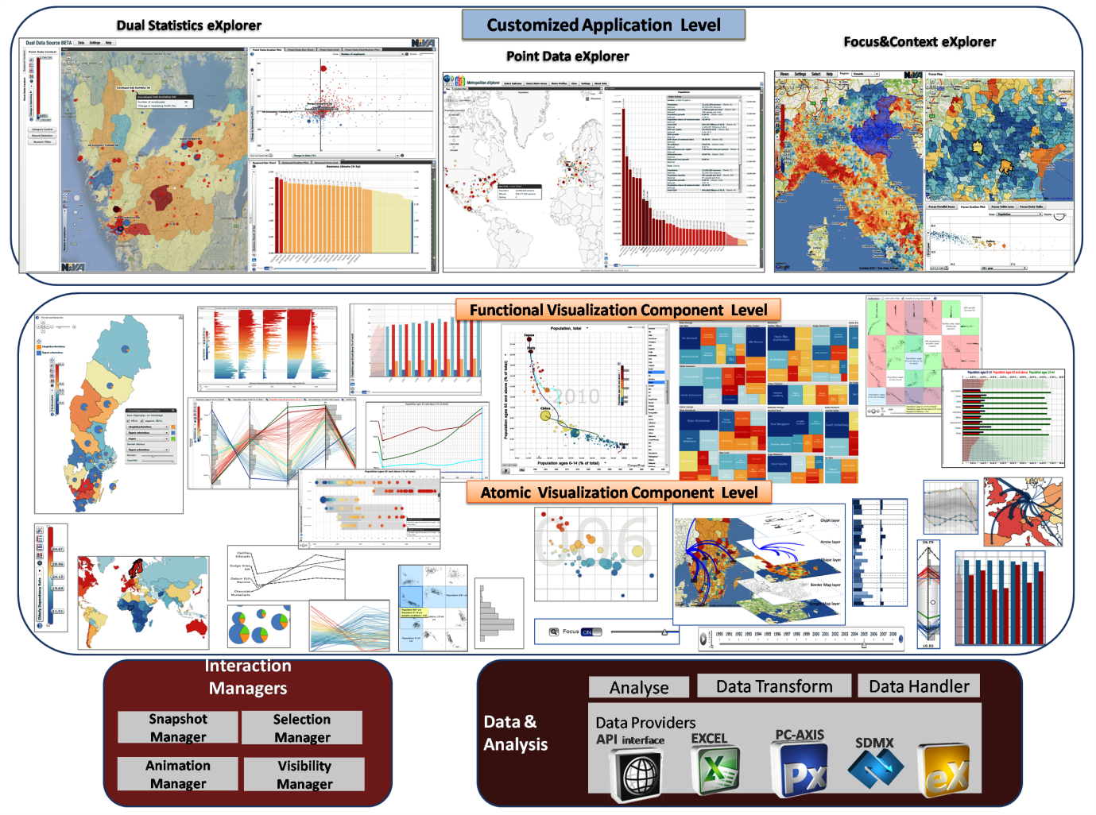

Slide 8
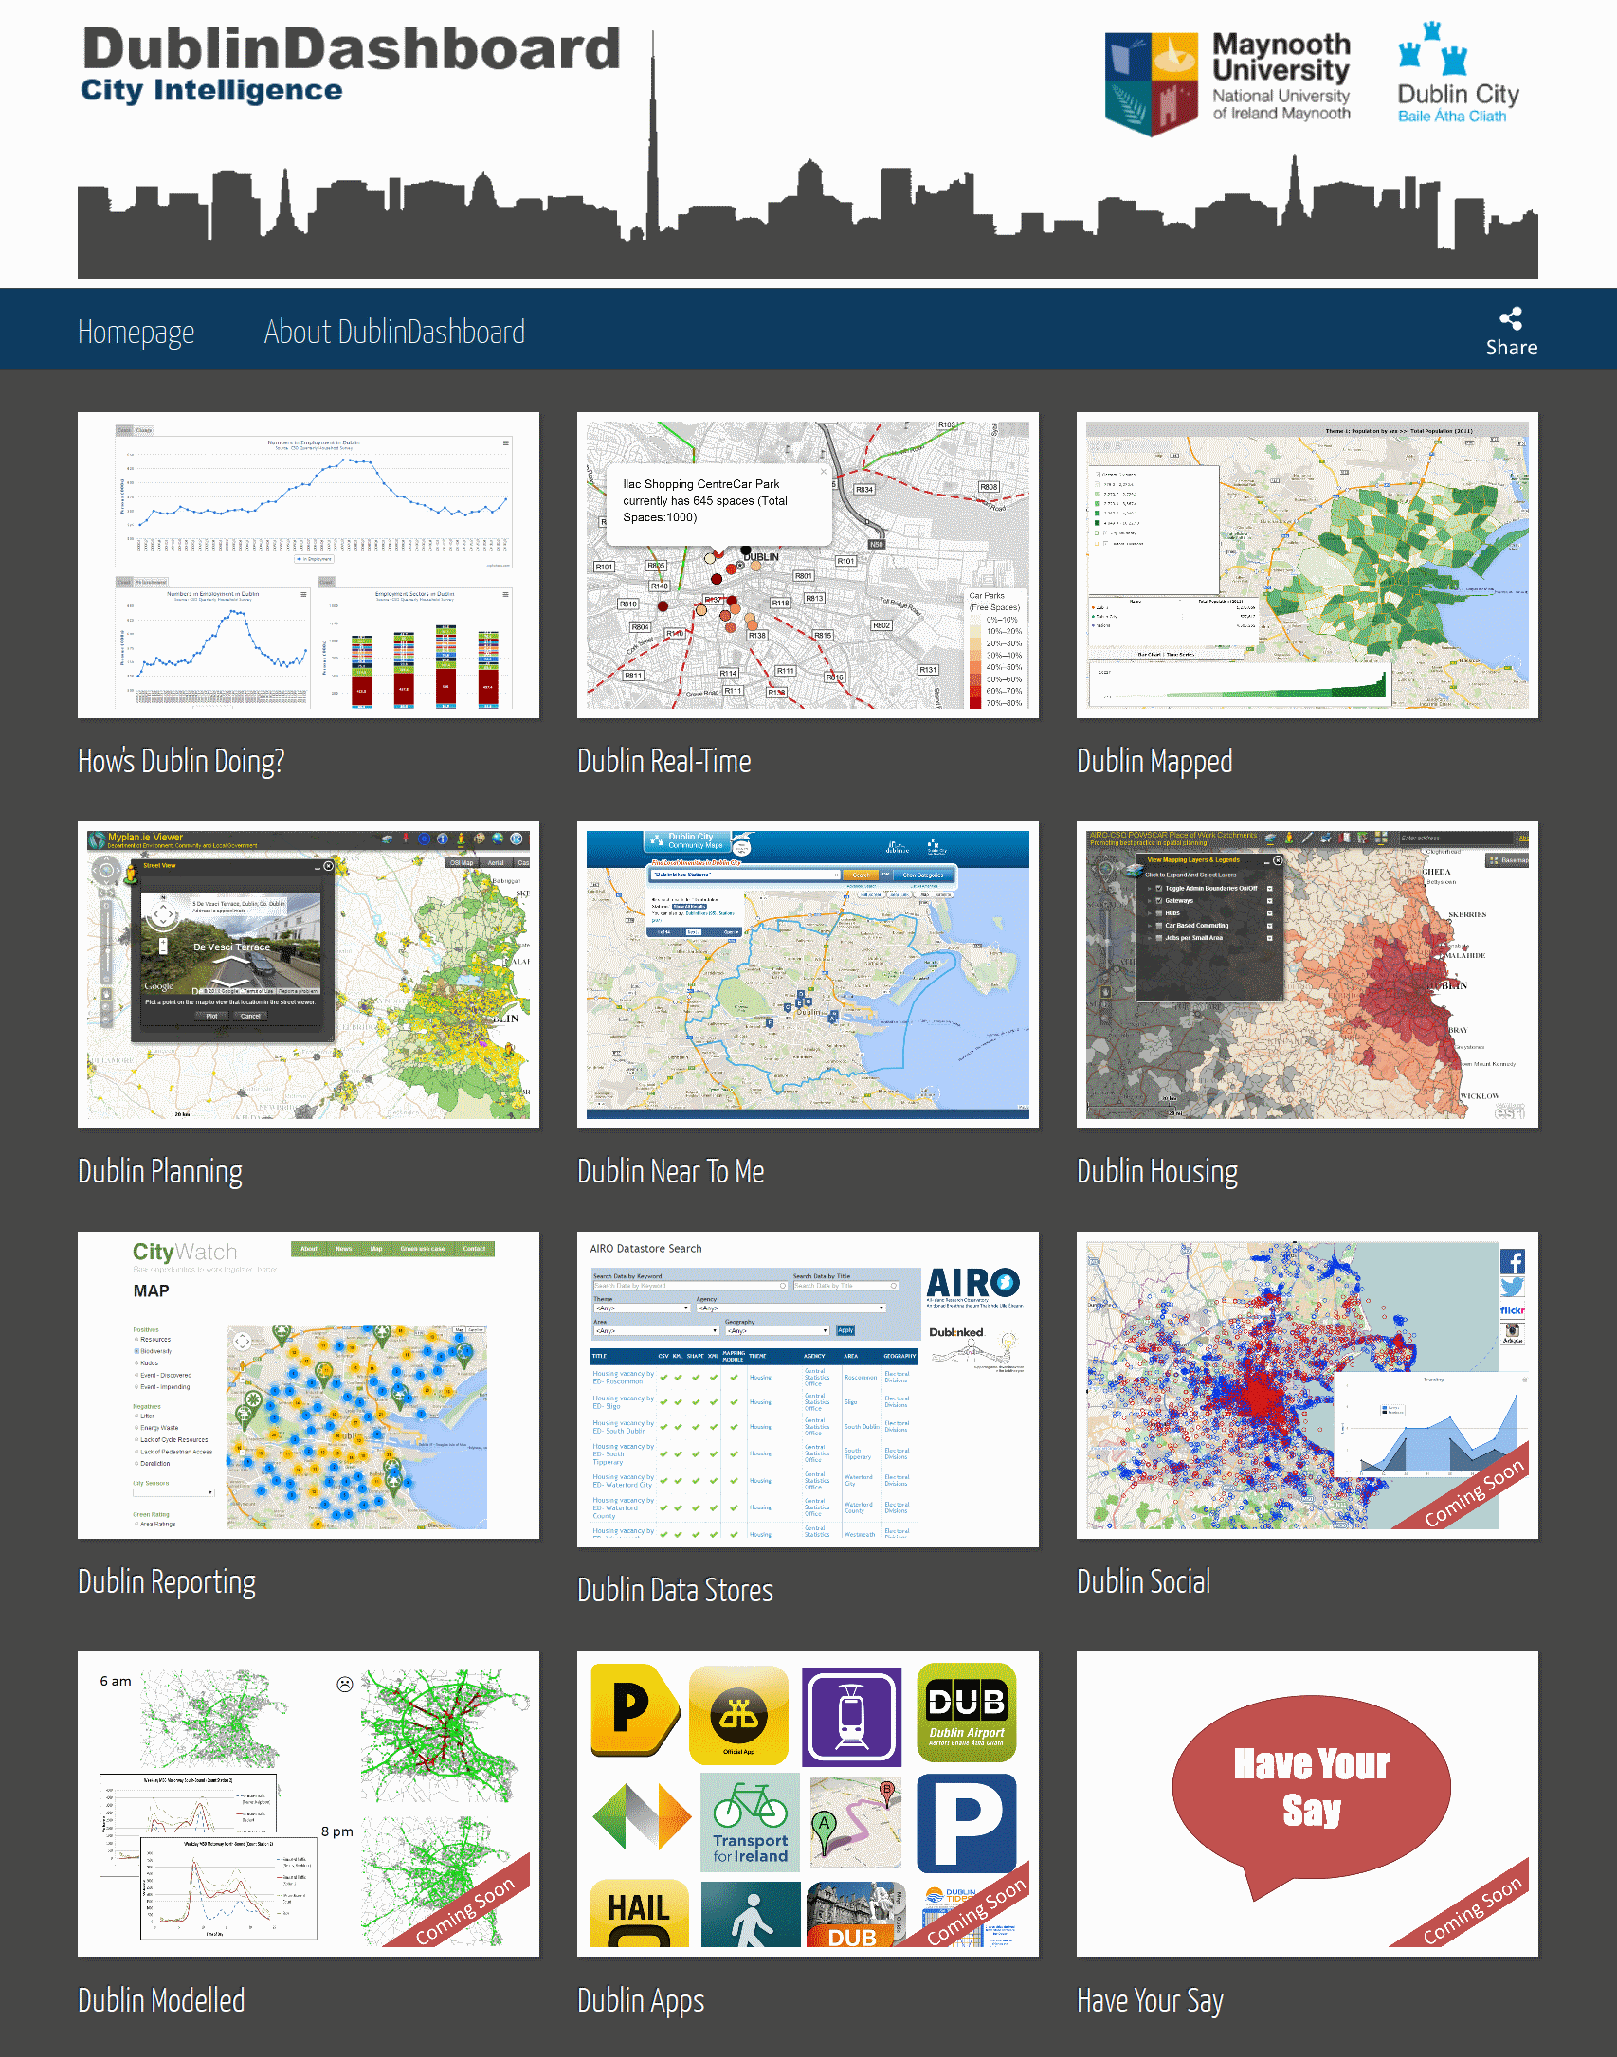
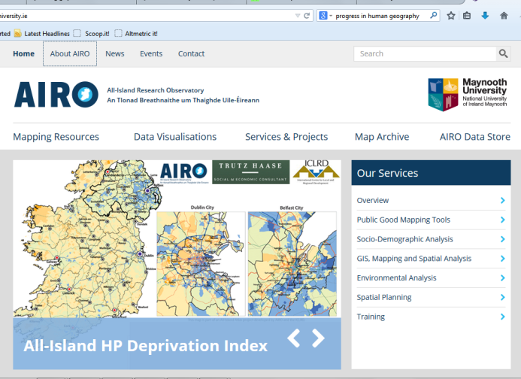
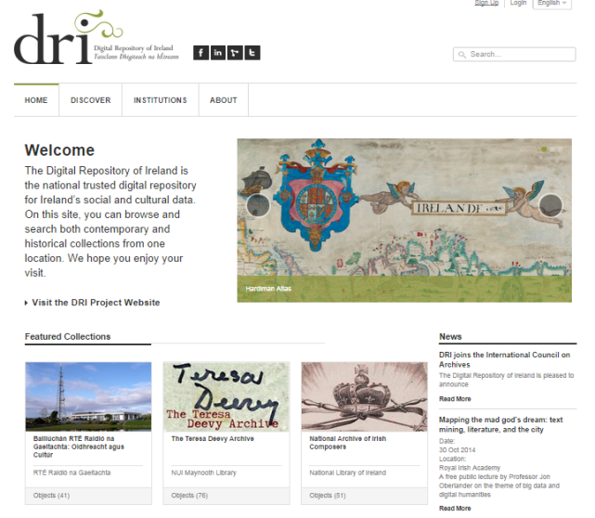
Geography produced through the digital
All-Island Research Observatory (AIRO; www.airo.ie)
Dublin Dashboard (www.dublindashboard.ie)
Digital Repository of Ireland (DRI; www.dri.ie)

Slide 9
Digital geographies?
The extent of work suggests that perhaps we should talk of a field of ‘digital geography’
Certainly a drive for ‘digital sociology’
However, given the growing pervasiveness of the digital in mediating the production of space and producing geographic knowledge does denoting such a field make sense?
It might be more productive to reframe much of what is being claimed as digital geography with respect to its substantive focus. For example
  examining the ways in which digital technologies are reshaping urban practices is perhaps best framed within urban geography
  examining the use of digital technology in the delivery of aid in parts of the Global South is perhaps best framed within development geography
In other words, it might be more profitable to think about how the digital reshapes many geographies, rather than to cast all of those geographies as digital geography

Slide 10
Conclusion
Regardless of how we want to position digital geographies within Geography there is little doubt that there is a growing body of work considering the:
  Geographies of the digital
  Geographies produced by the digital
  Geographies produced through the digital
And yet there is substantially more that needs to be done conceptually, methodologically and empirically to make sense of and research digital geographies and to try and do so in a timely manner to keep up with a fast changing ICT landscape

Slide 11
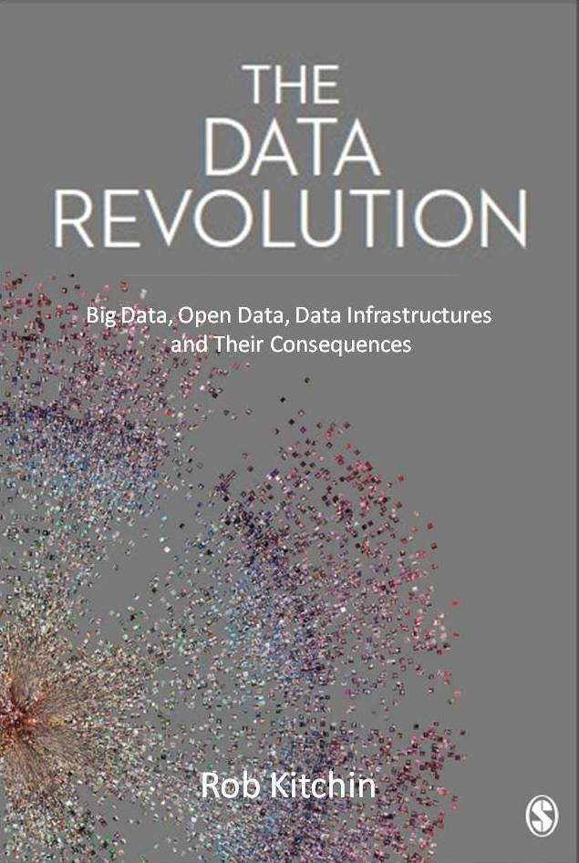

Rob.Kitchin@nuim.ie
@robkitchin
http://www.nuim.ie/progcity
@progcity

