Slide 1
code, content, and control global geographies of digital participation and representation
Digital Geographies
March 24, 2015
Mark Graham and Joe Shaw
Oxford Internet Institute
University of Oxford
mark.graham@oii.ox.ac.uk
@geoplace

Slide 2
“The digital in development and what
this means for digital geography.”

Slide 3
mutable im/mobiles
[content] [containers]

Slide 4
immutable mobiles
[content | containers]

Slide 5
im/mutable augmentations
[content] [containers]

Slide 6
augmented realities

Slide 7
Notes:
http://www.nydailynews.com/entertainment/music-arts/bam-hosts-gif-exhibit-new-york-city-article-1.1304633

Slide 8
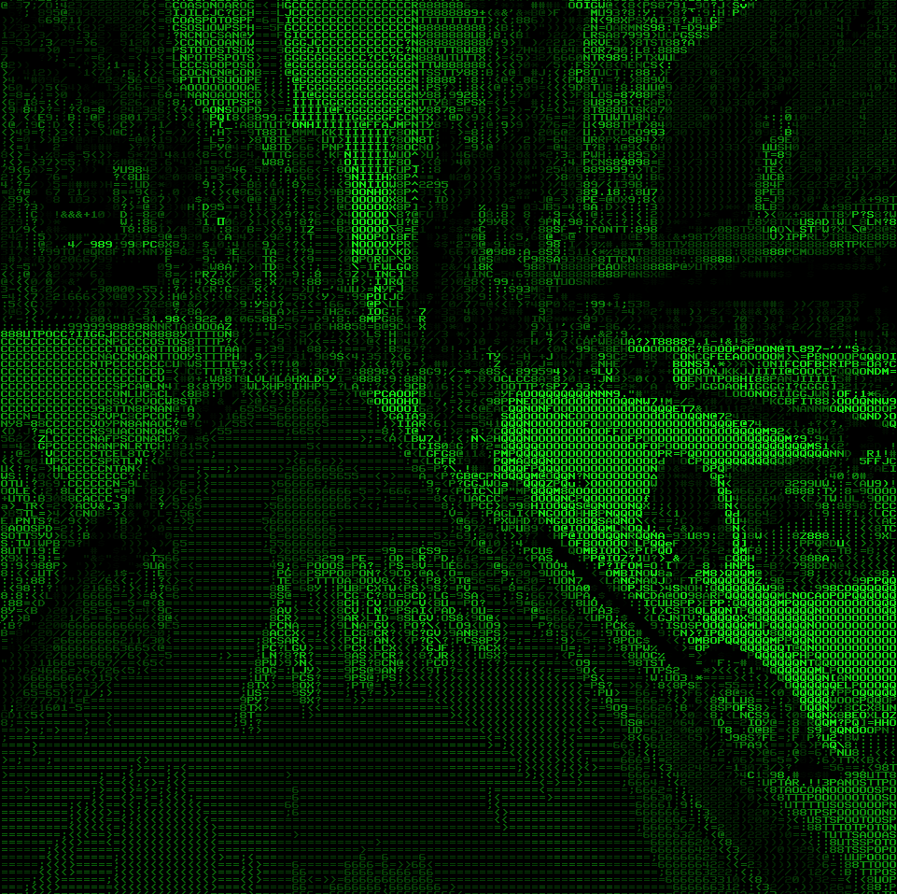
tllabs.io/asciistreetview/

Slide 9
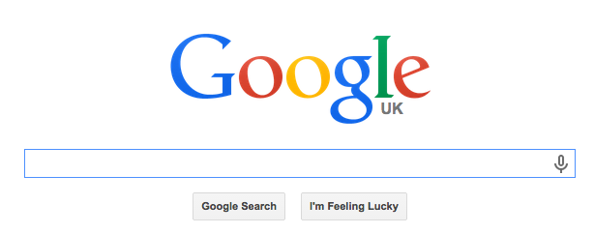

Slide 10
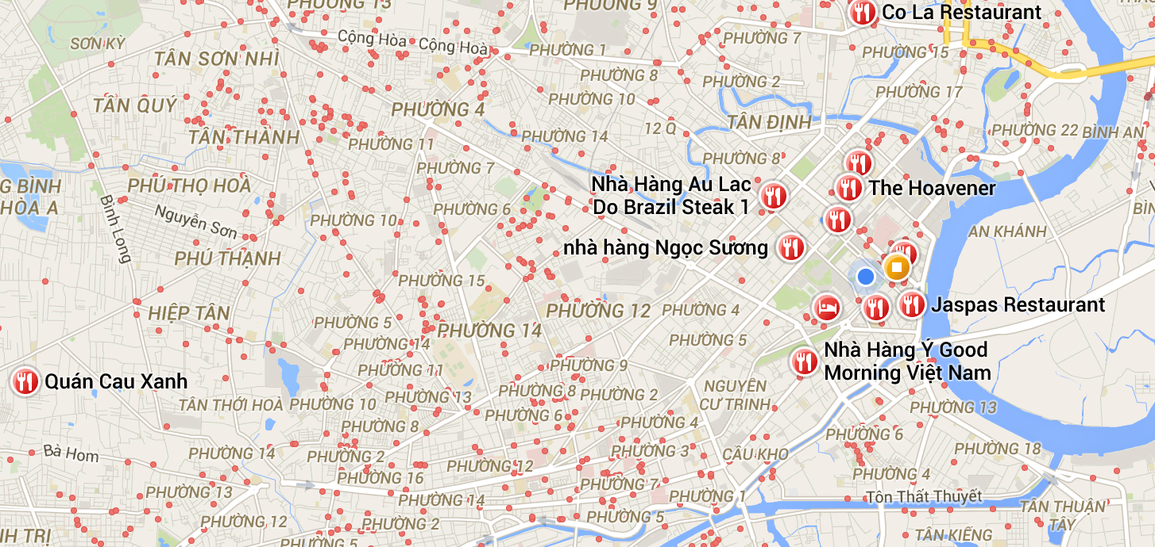

Slide 11
Google stock price

Slide 12
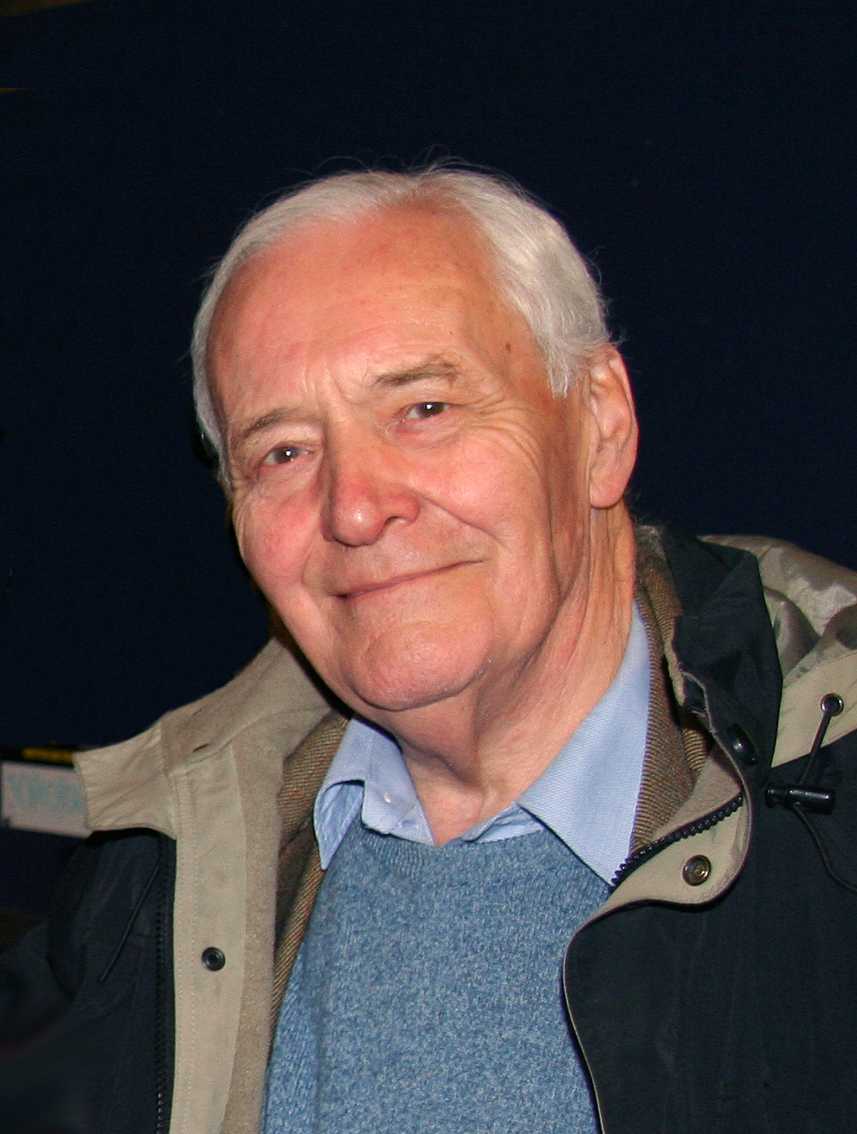

Slide 13
What power have you got?
Where did you get it from?
In whose interests do you exercise it?
To whom are you accountable?
And how can we get rid of you?

Slide 14
What power have you got?
Where did you get it from?
In whose interests do you exercise it?
To whom are you accountable?
And how can we get rid of you?

Slide 15
code and algorithms

Slide 16
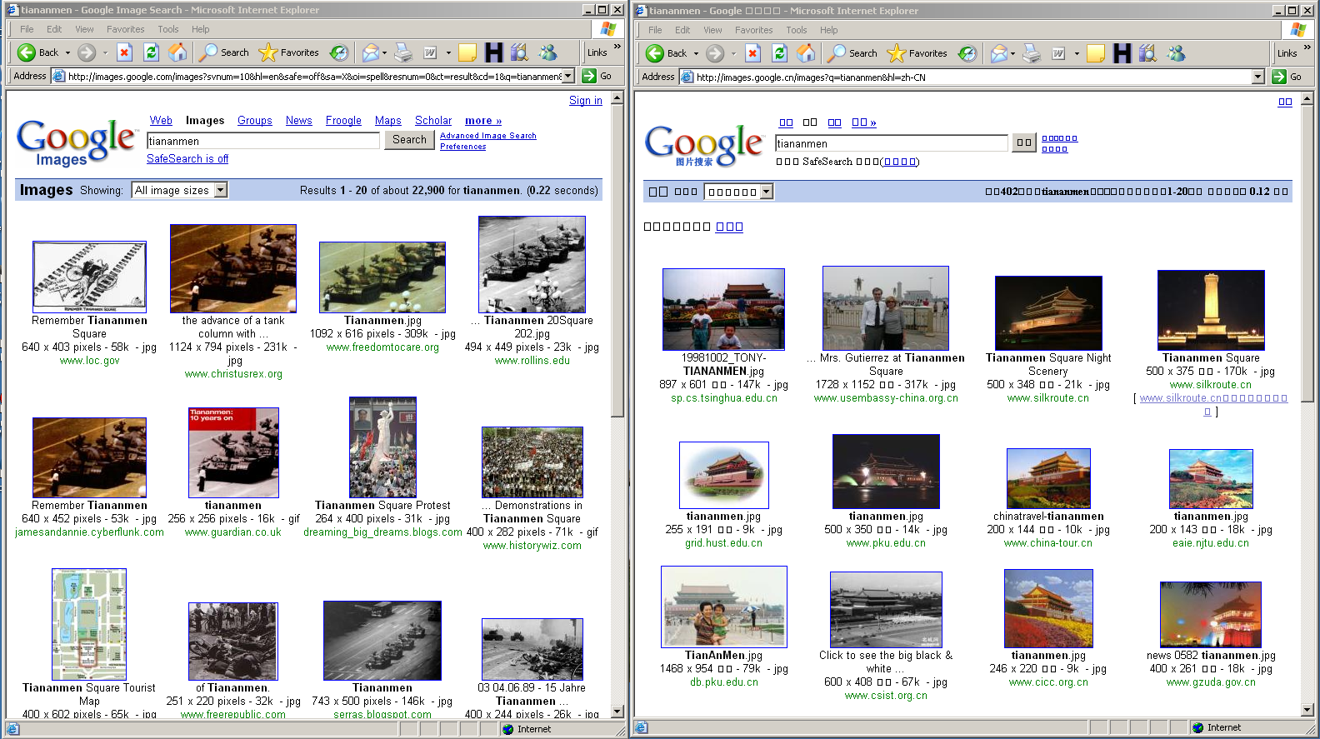
code and algorithms

Slide 18
“Hi Mark, Thank you for your interest in GoogleLocal (beta). At this time, we don't provide this information. However, we appreciate your feedback on the usefulness of this information. Thank you for your support as we work to improve GoogleLocal. Regards, The Google Team.”
(a message they sent to me in 2006)

Slide 19
design and data/system architectures

Slide 20
systems of governance

Slide 21
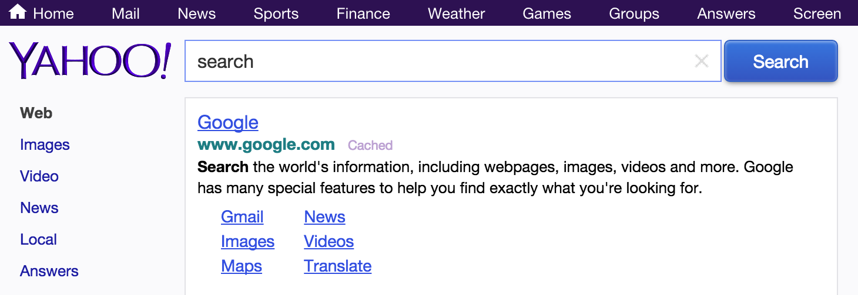
through centrality in an
attention economy

Slide 22
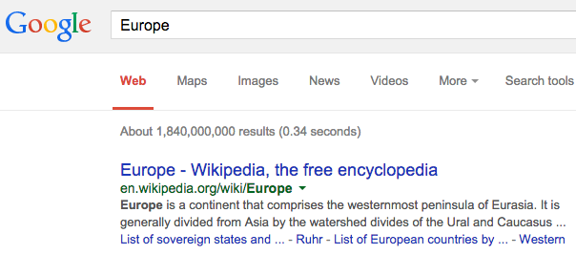

Slide 23
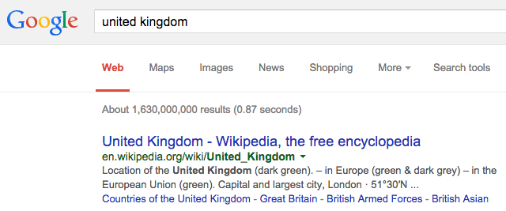

Slide 24
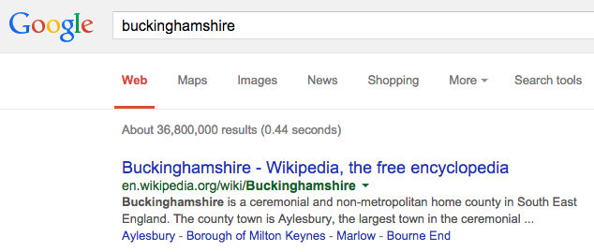

Slide 25
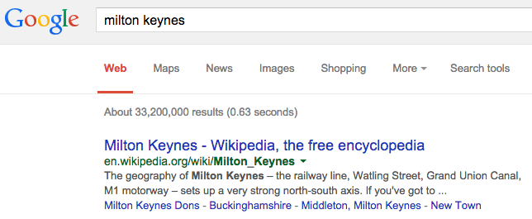

Slide 26
data presences and absences

Slide 27
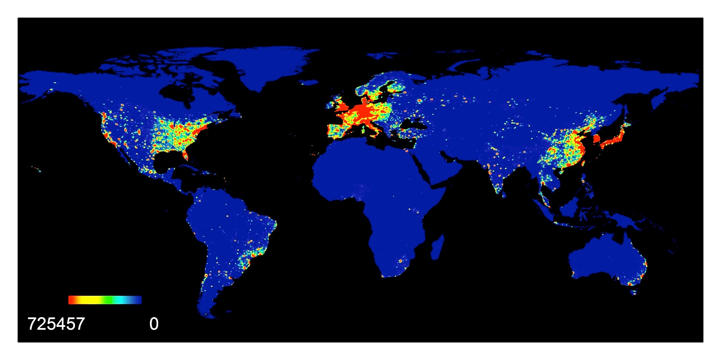
Map by Mark Graham, Monica Stephens, Matthew Zook

Slide 28
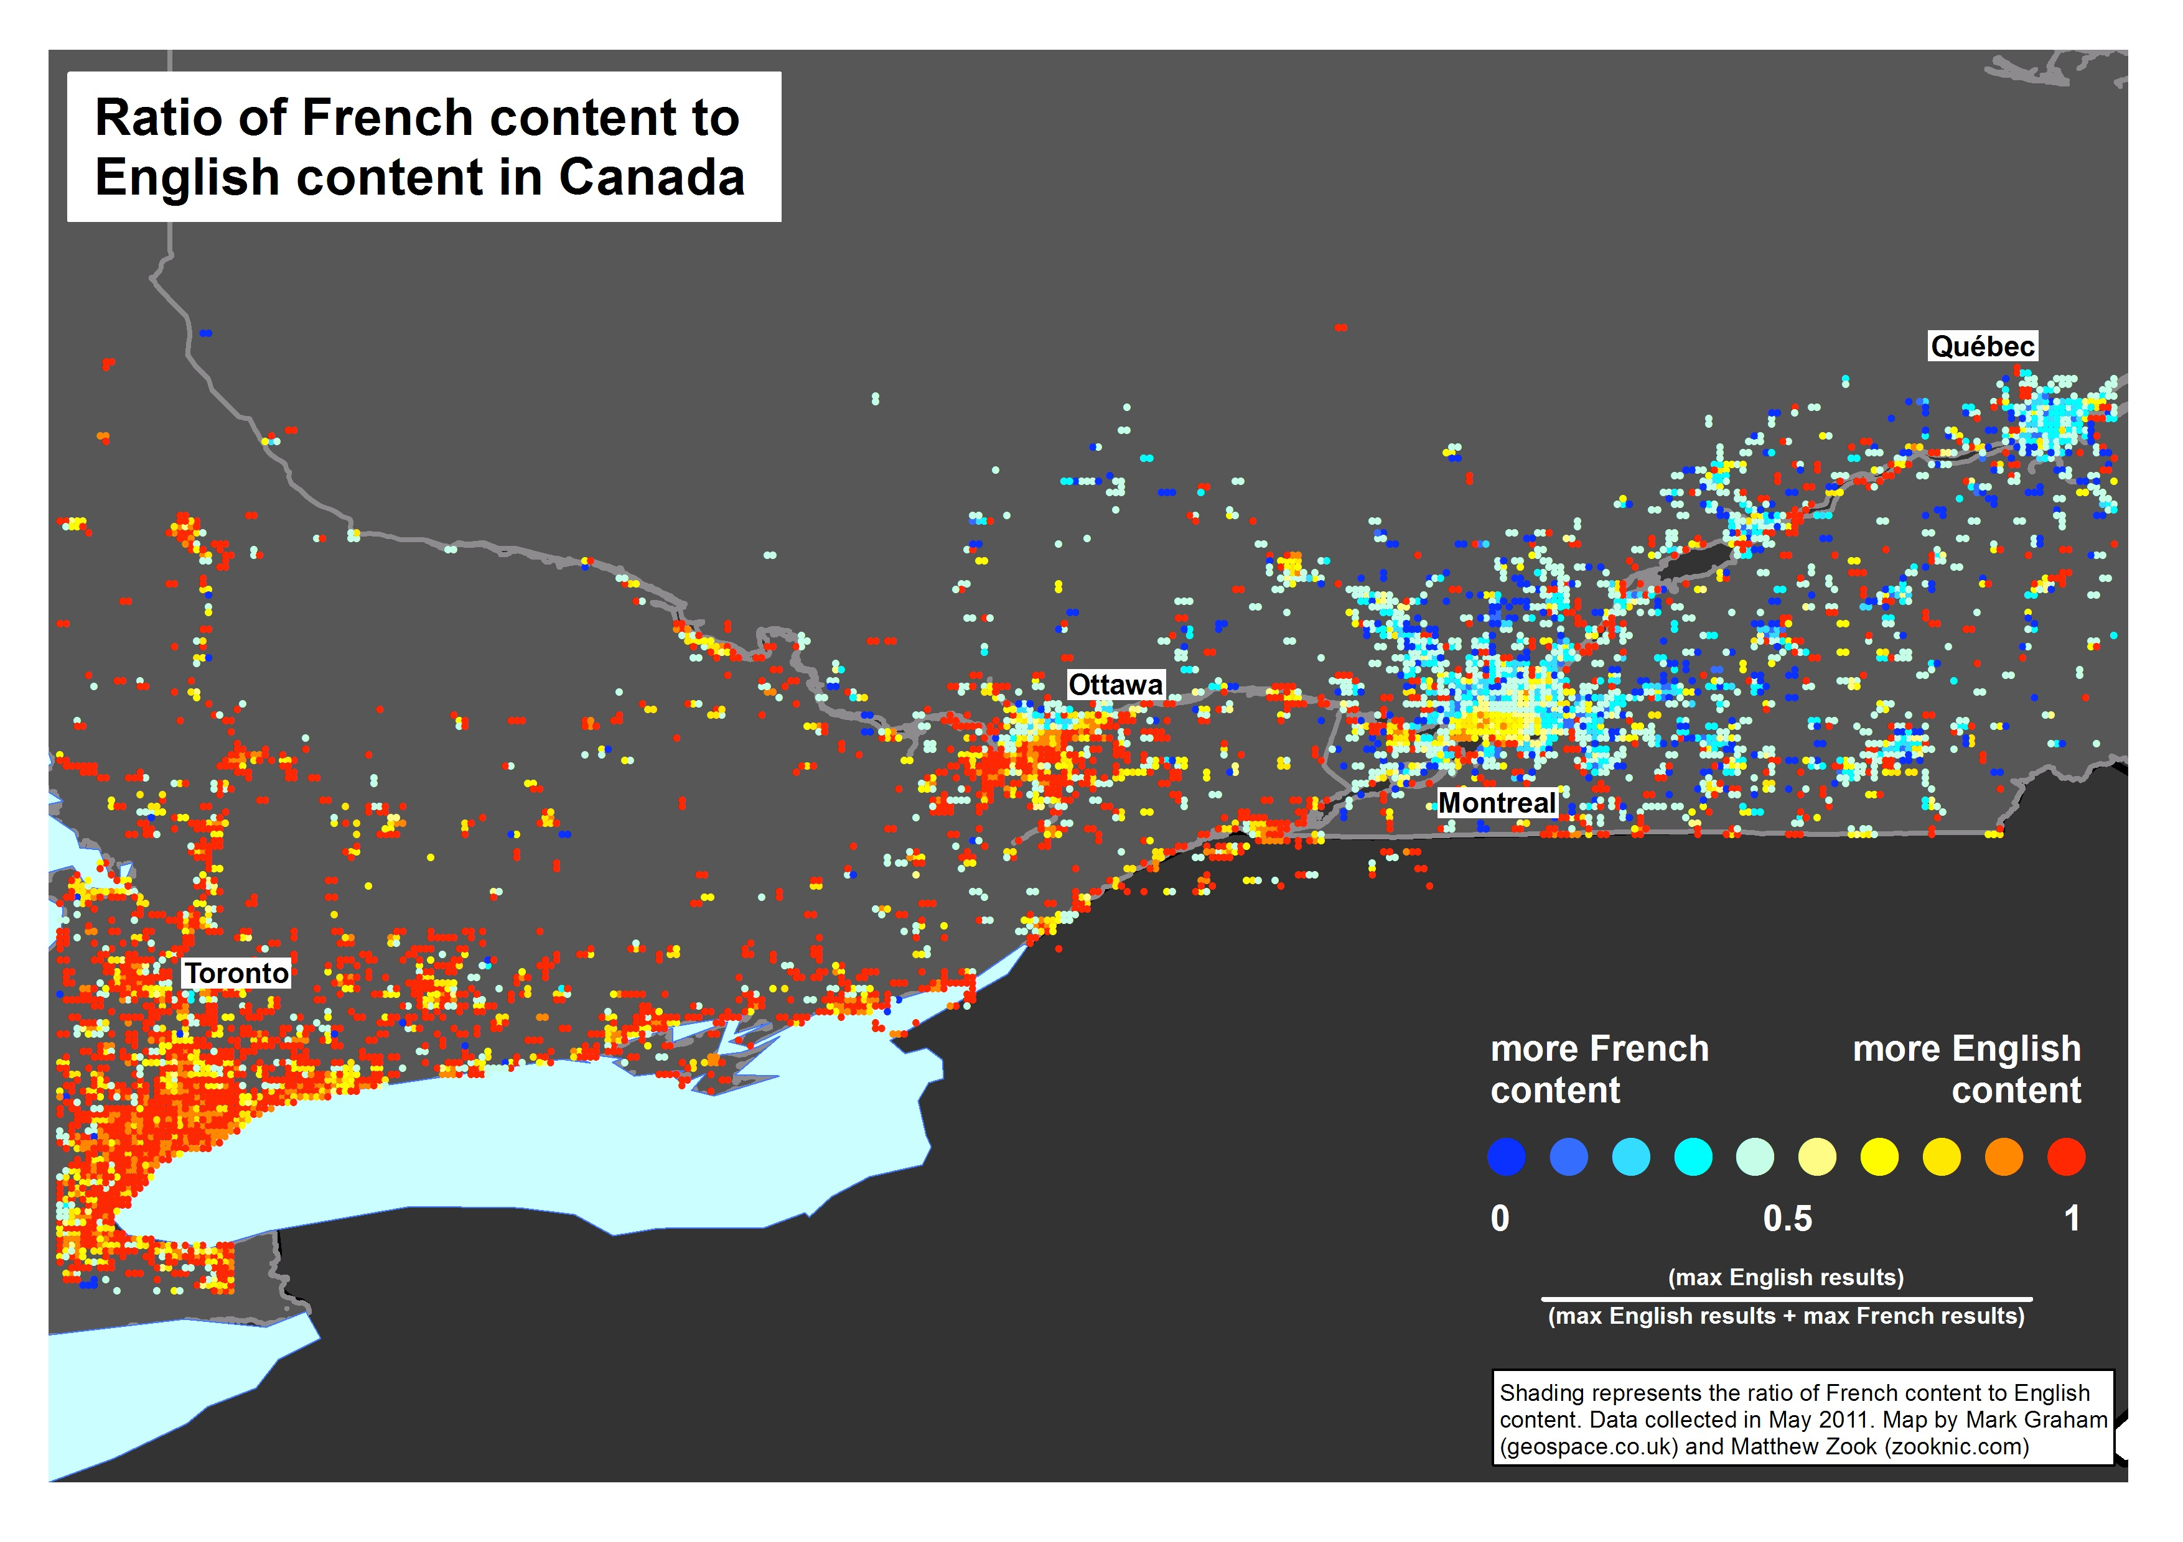

Slide 29
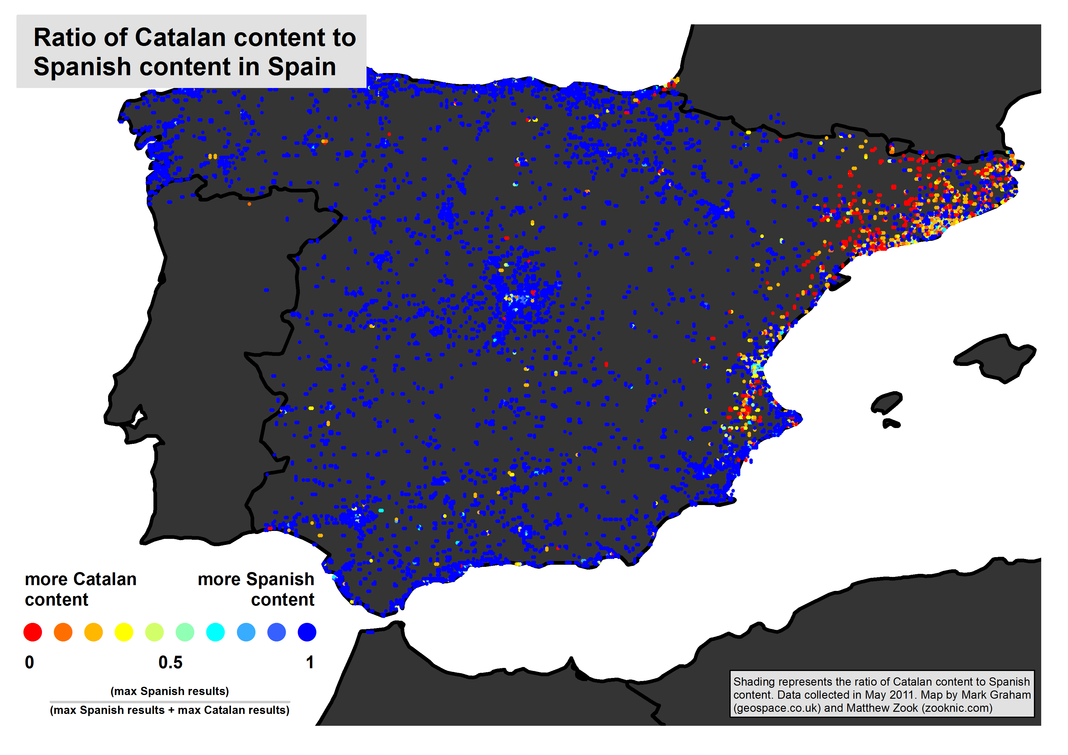

Slide 30
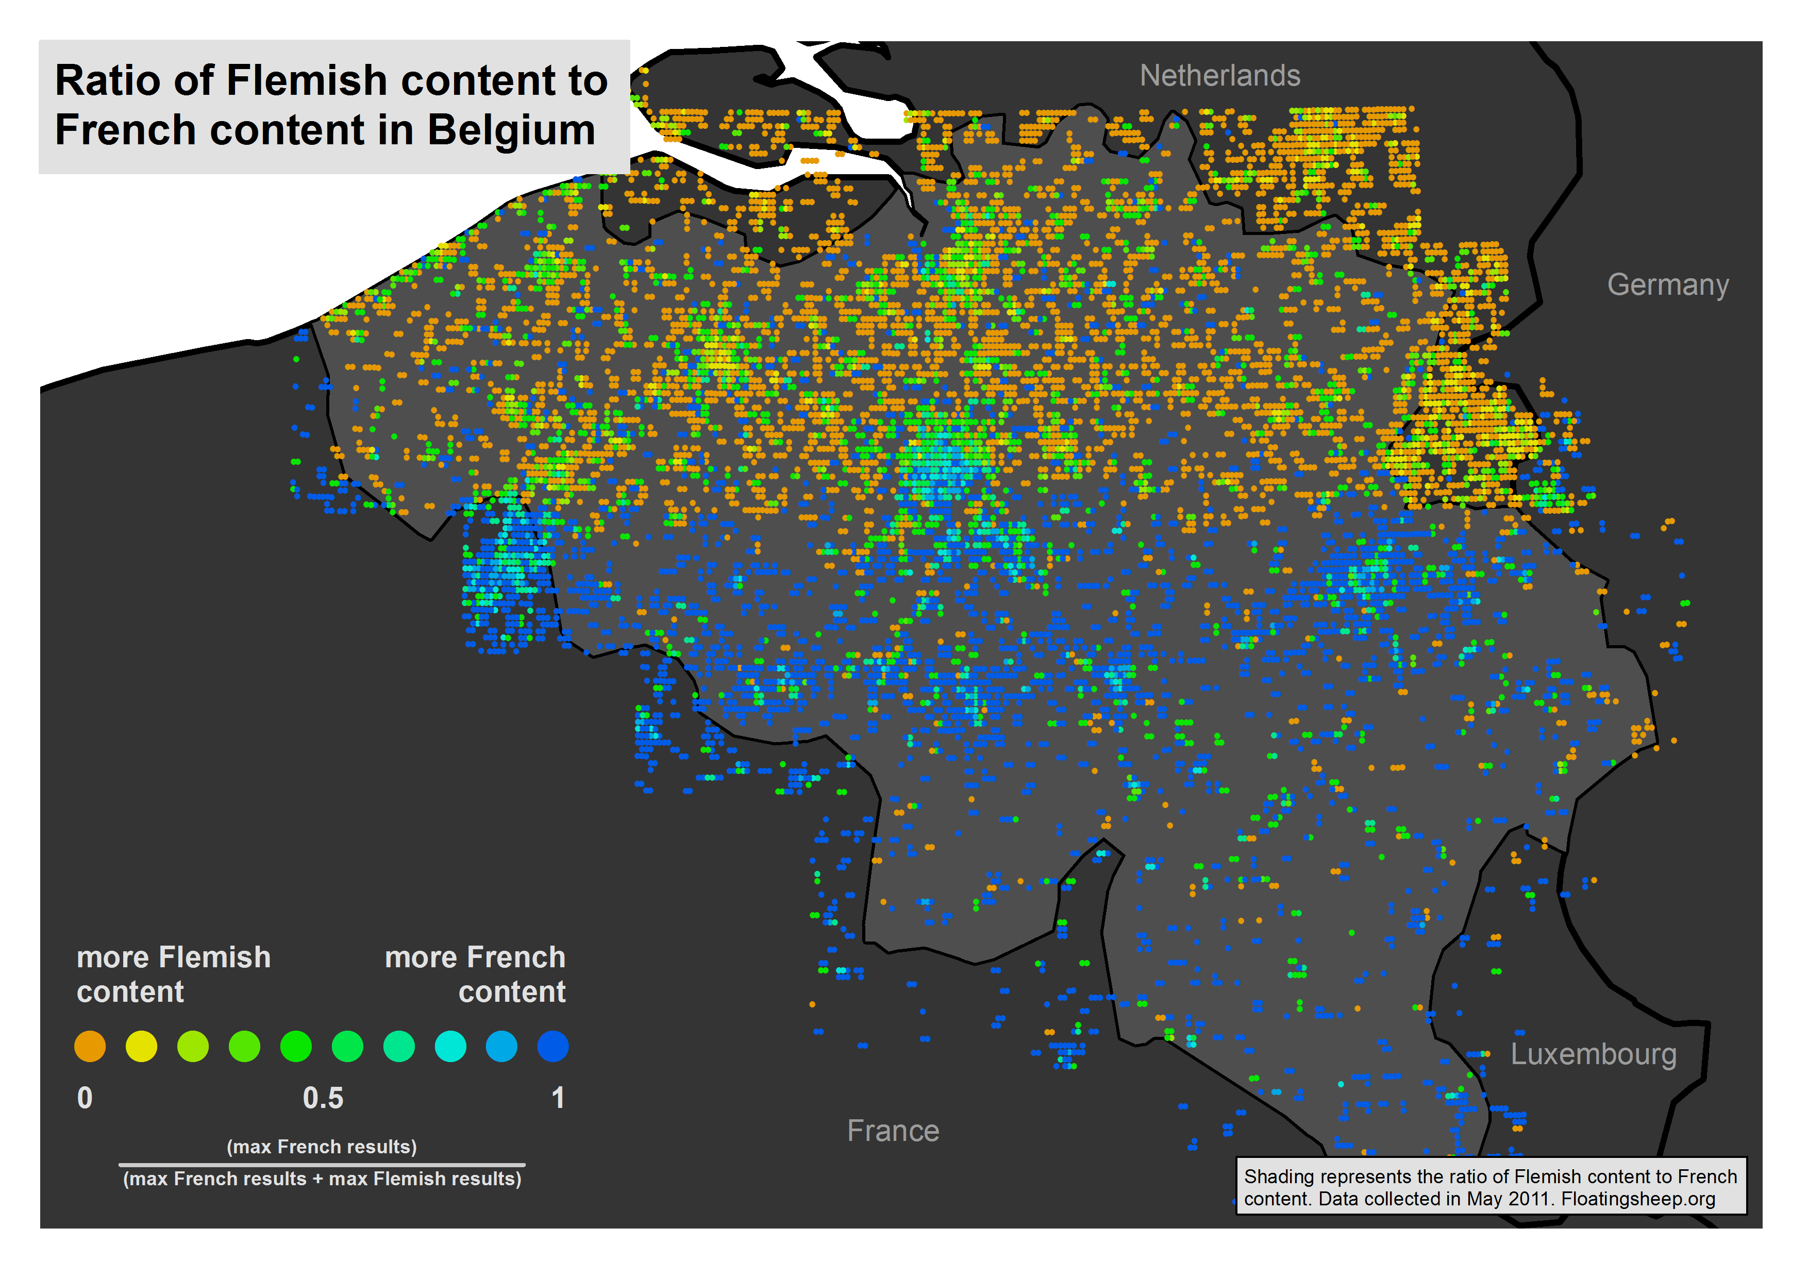

Slide 31
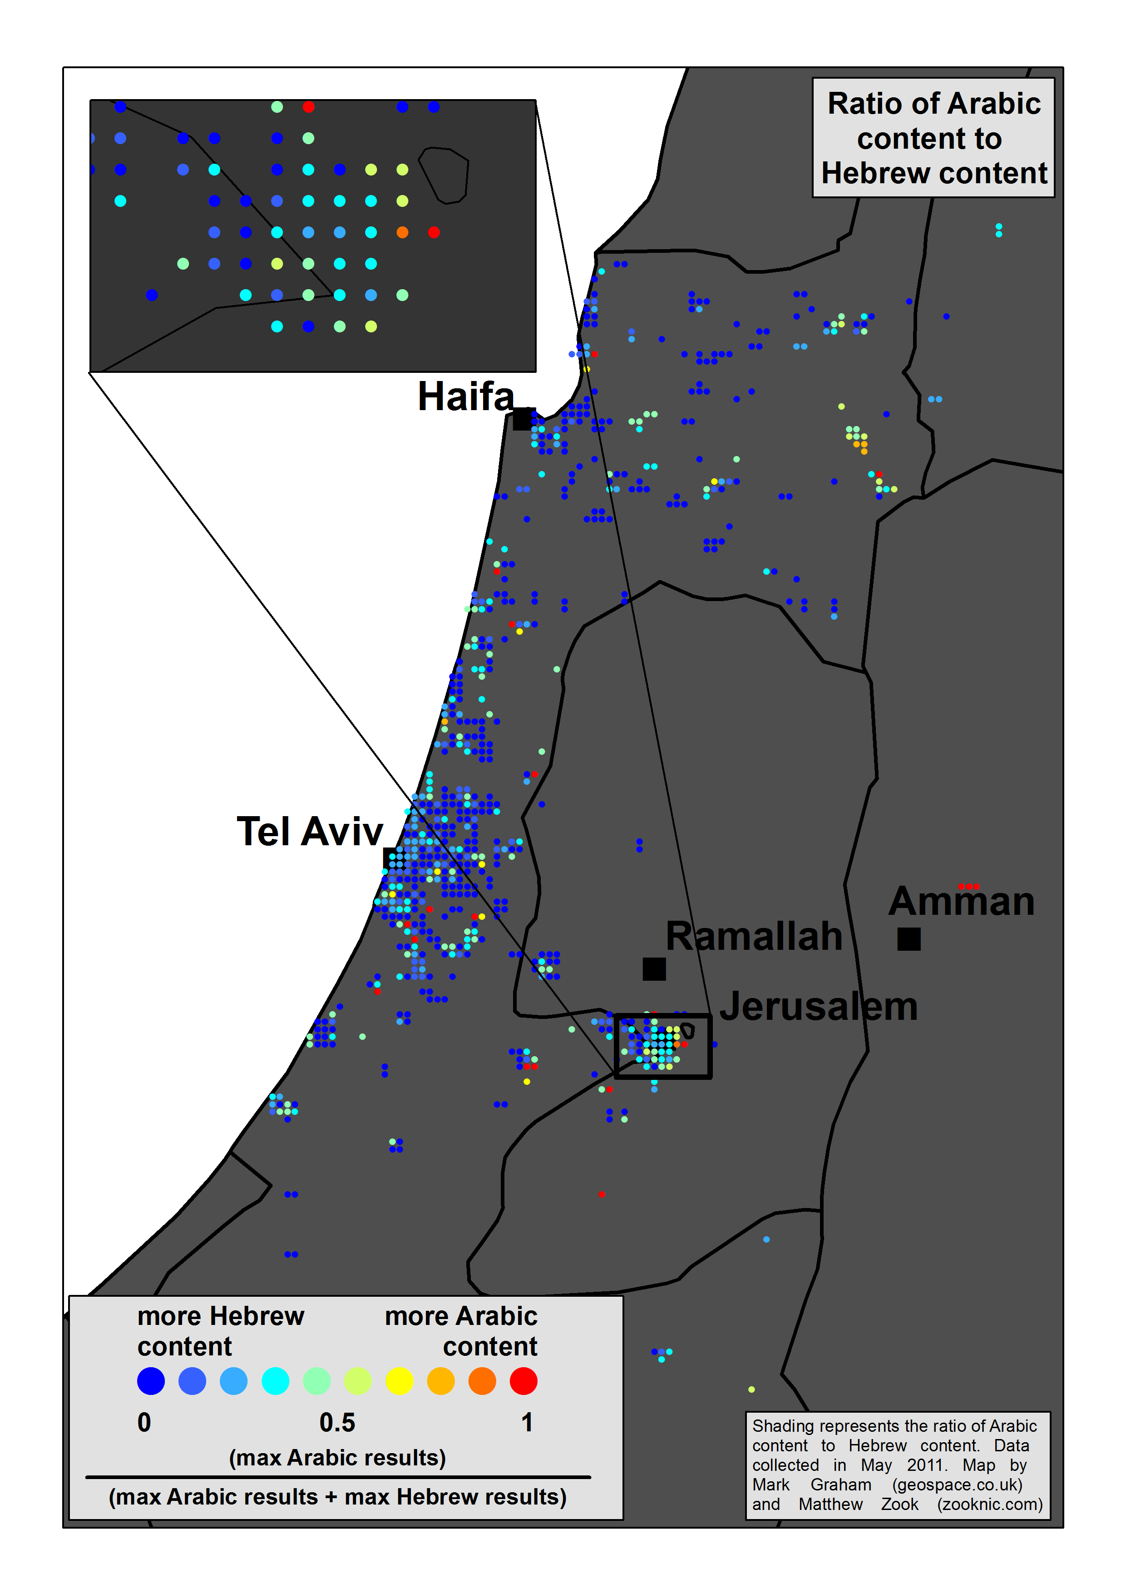

Slide 32
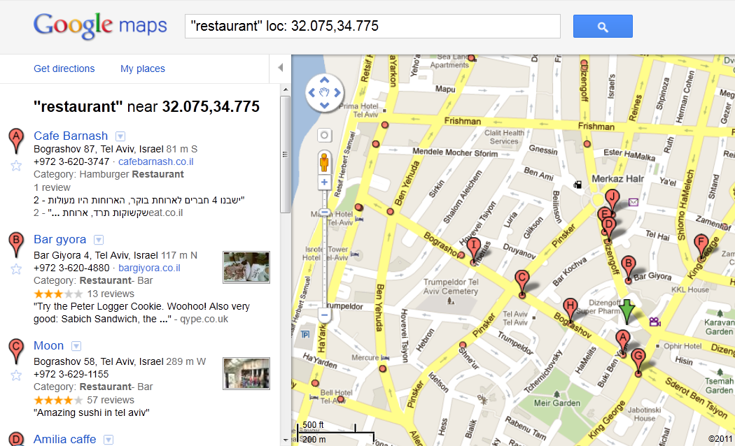

Slide 33
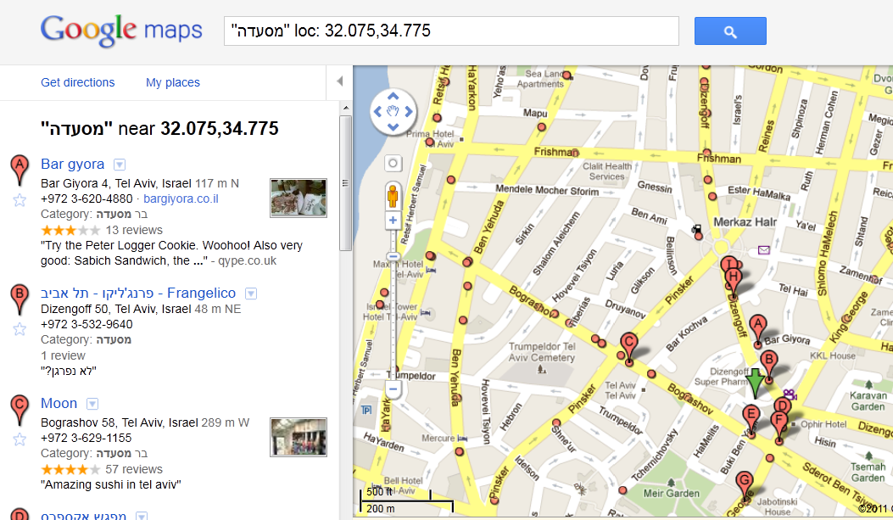

Slide 34
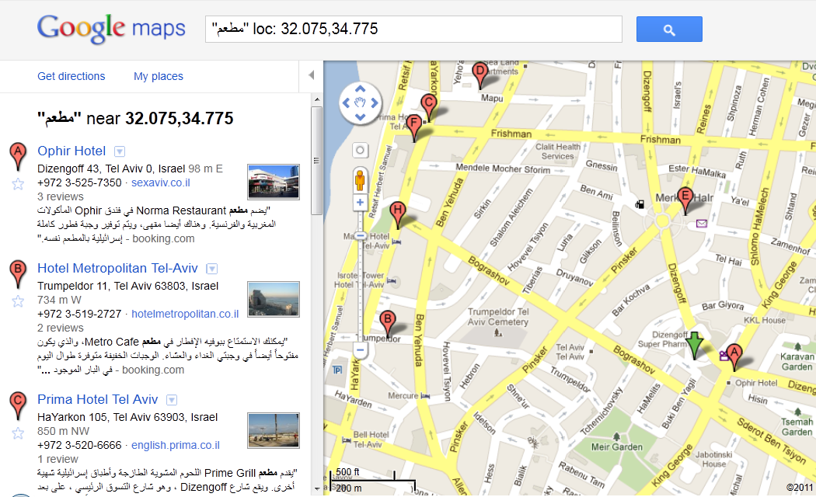

Slide 35
www.oii.ox.ac.uk/vis

Slide 36
www.oii.ox.ac.uk/vis

Slide 37
www.oii.ox.ac.uk/vis

Slide 38
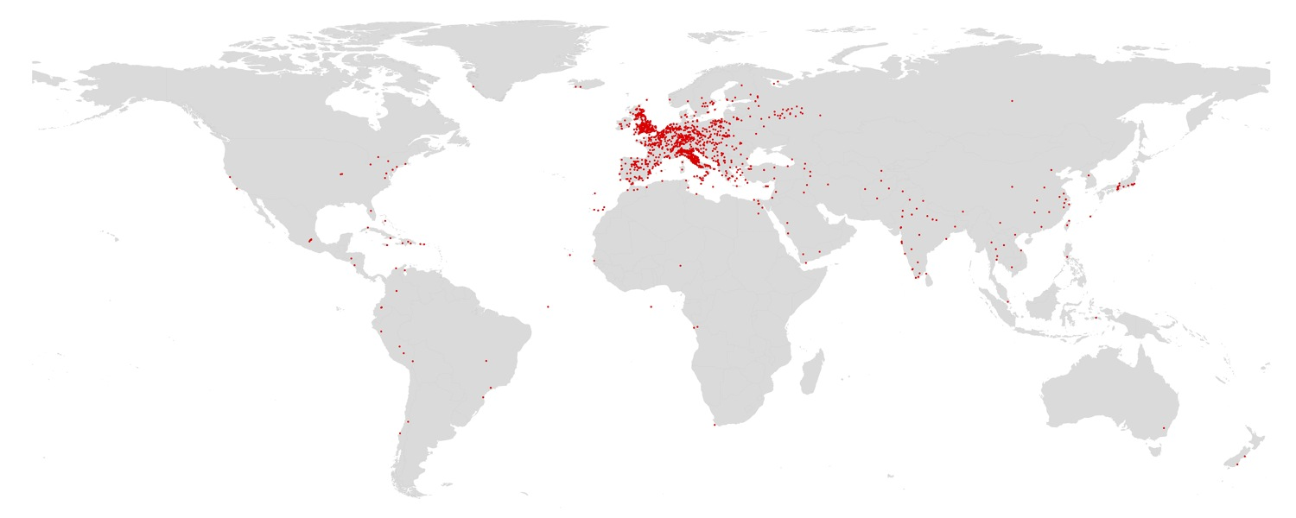
15th century
Notes:
15th C

Slide 39
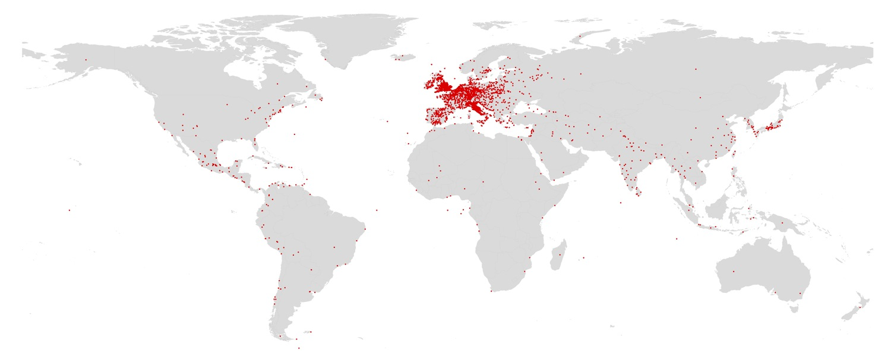
16th century
Notes:
16th C

Slide 40
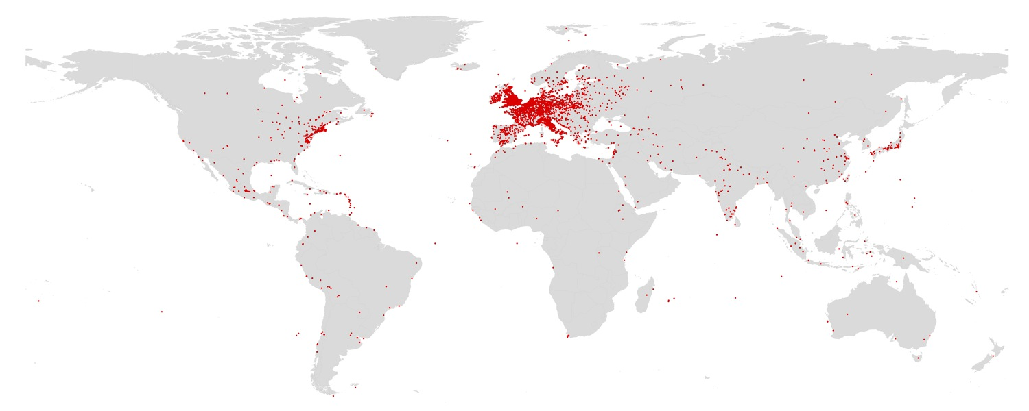
17th century
Notes:
17th C

Slide 41
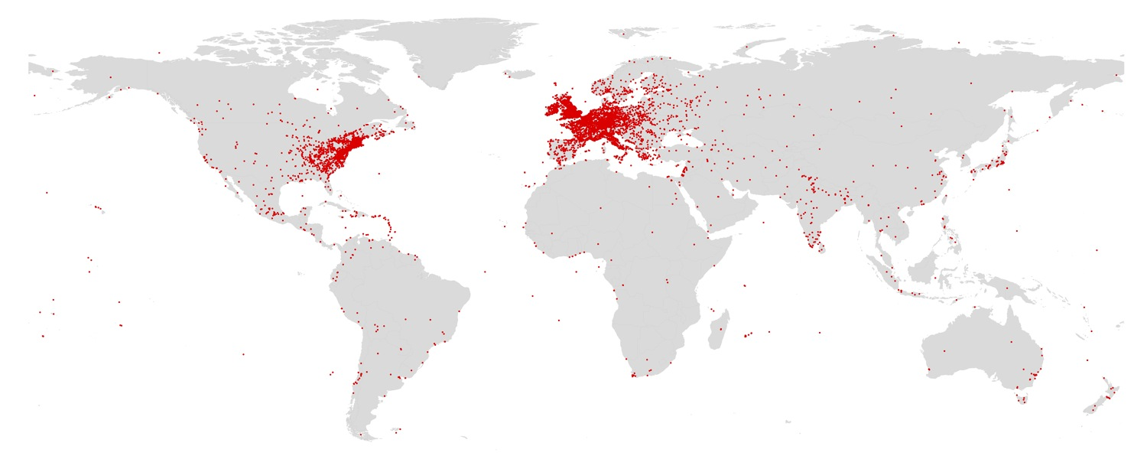
18th century
Notes:
18th C

Slide 42
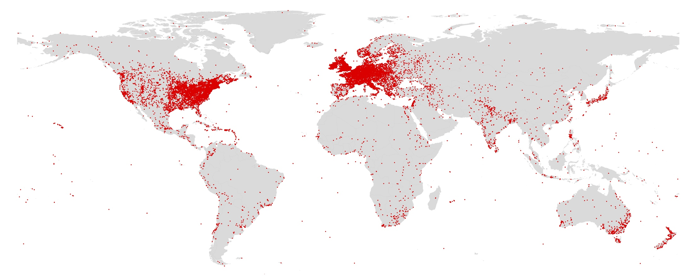
19th century
Notes:
18th C

Slide 43
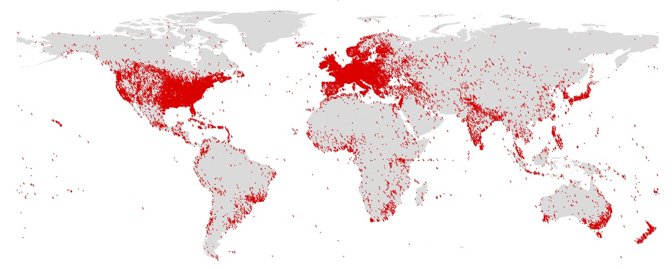
20th century
Notes:
20th C

Slide 44
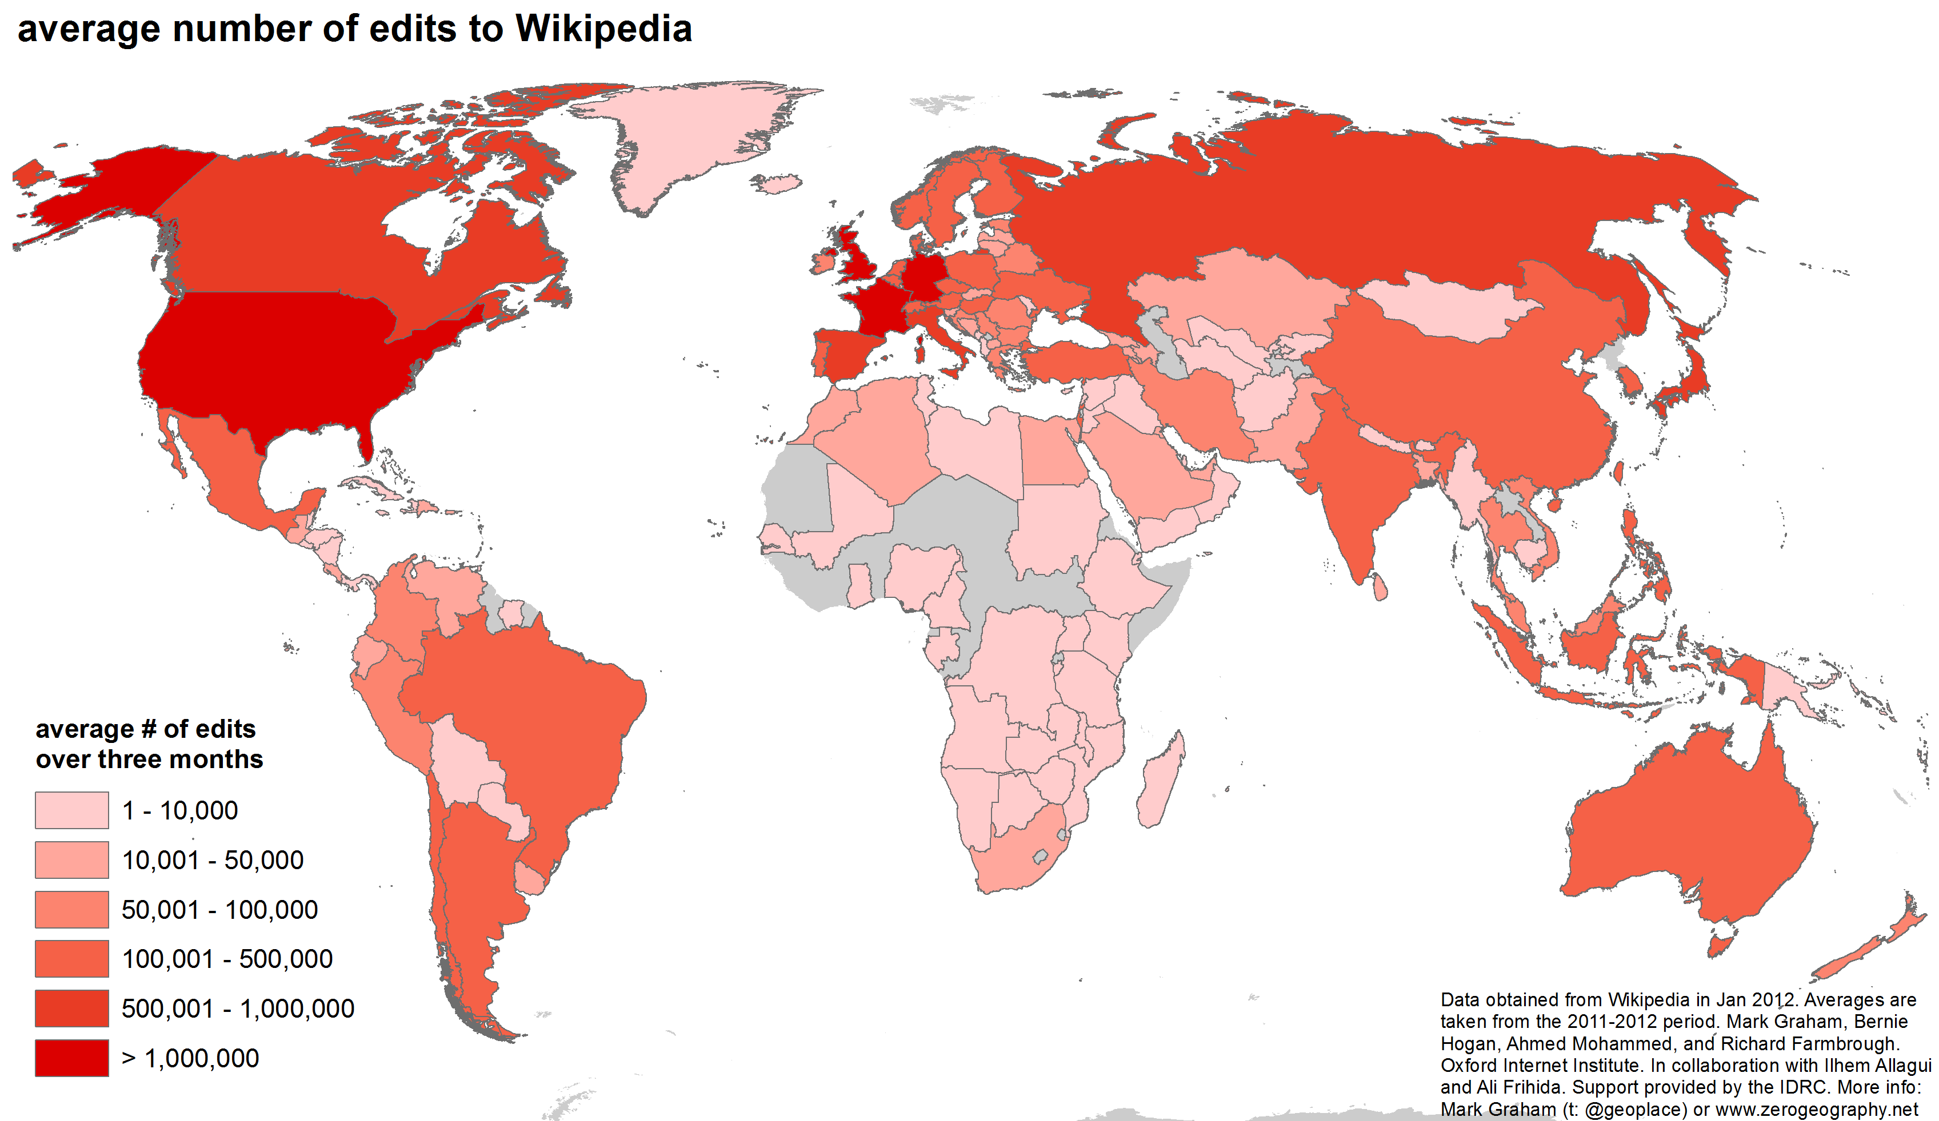

Slide 45
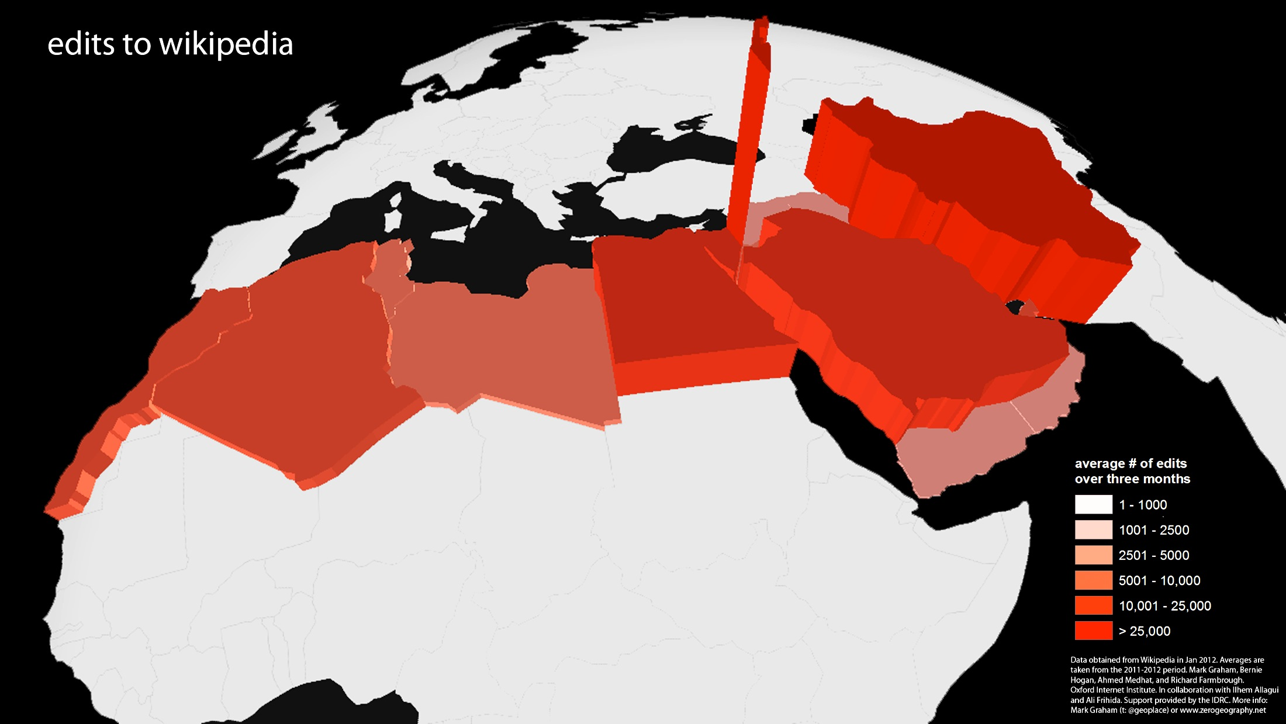

Slide 46
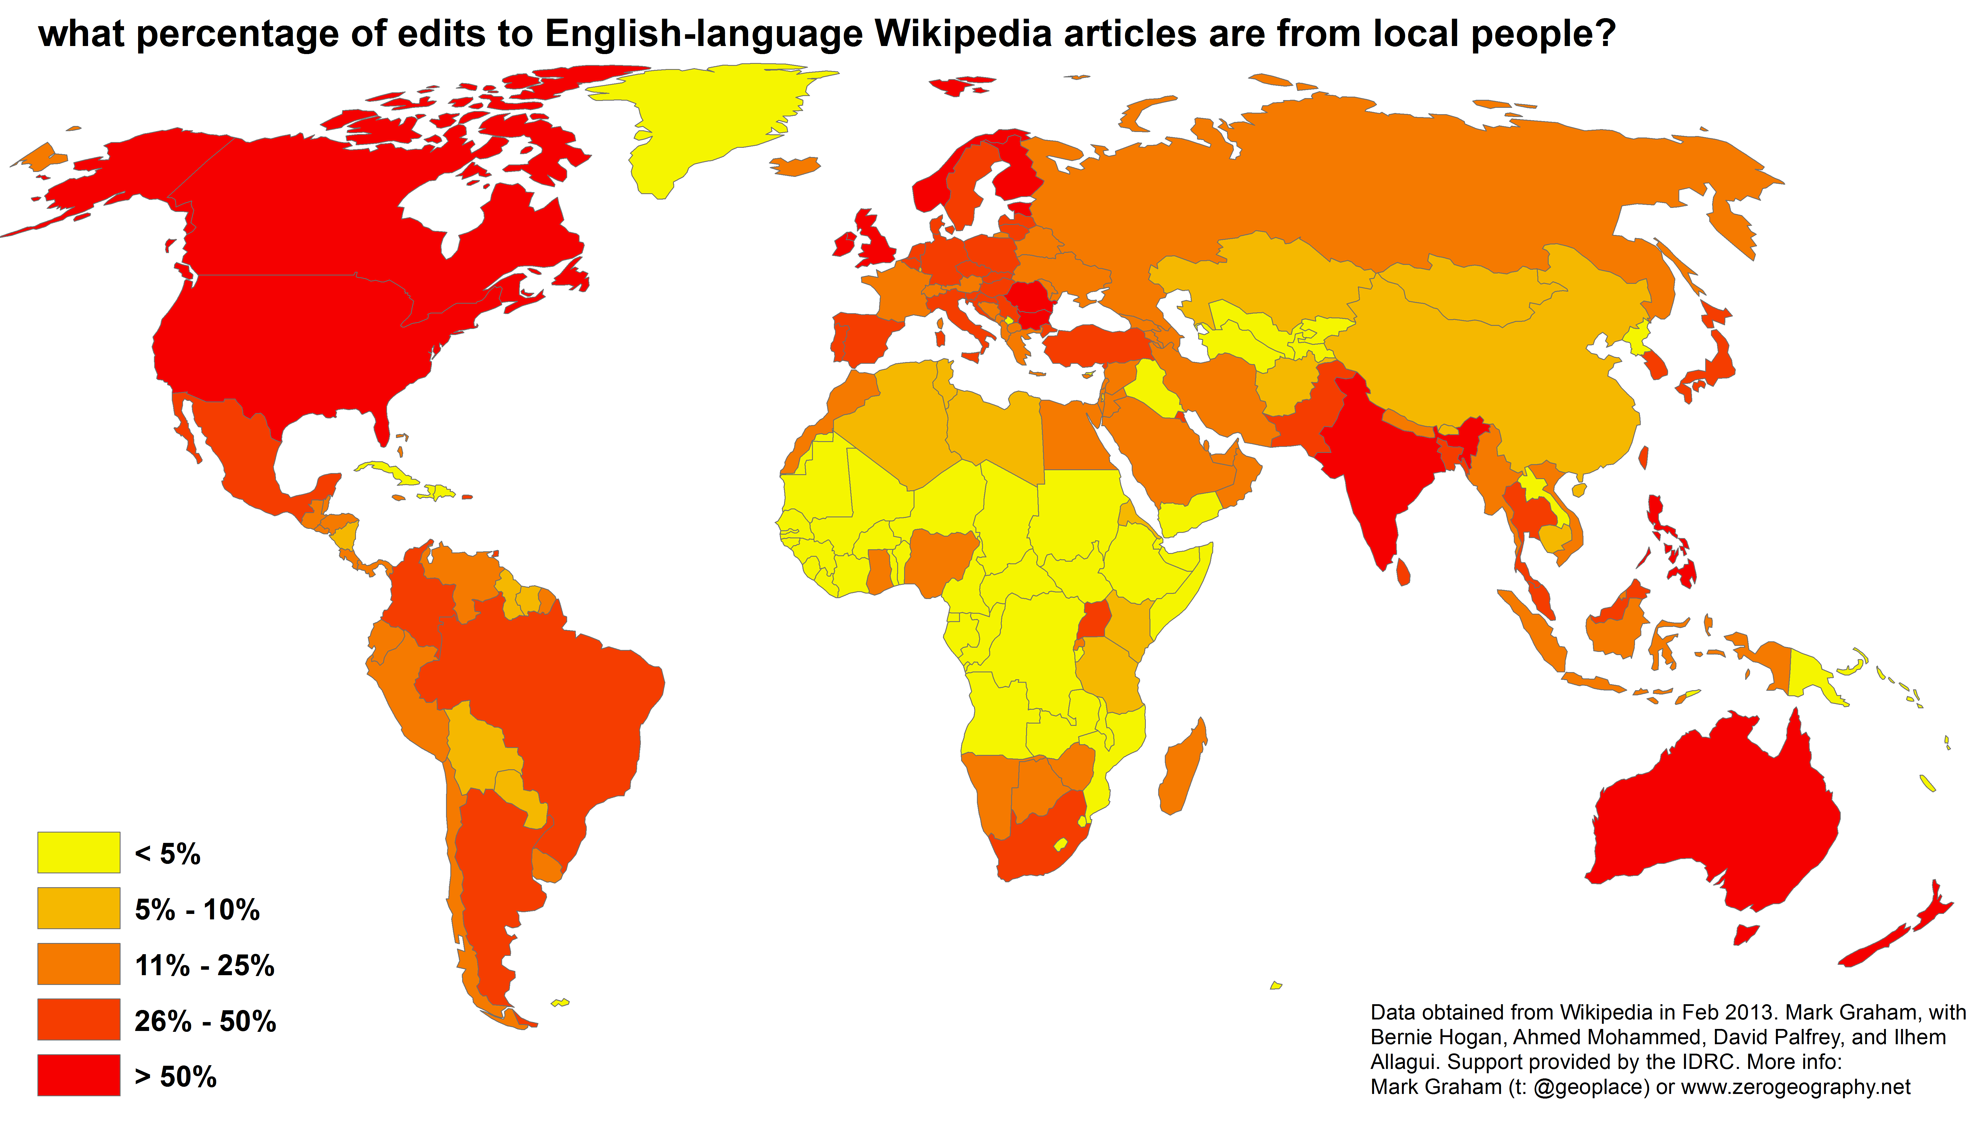

Slide 47
data presences and absences

Slide 48
What power have you got?
Where did you get it from?
In whose interests do you exercise it?
To whom are you accountable?
And how can we get rid of you?

Slide 49
What power have you got?
Where did you get it from?
In whose interests do you exercise it?
To whom are you accountable?
And how can we get rid of you?

Slide 50
an informational right to the city
“The right to the city is far more than the individual liberty to access urban resources: it is a right to change ourselves by changing the city.”
“The freedom to make and remake our cities and ourselves is, I want to argue, one of the most precious yet most neglected of our human rights.”
- Harvey 2008

Slide 51
tllabs.io/asciistreetview/

Slide 52
Related work: Graham, M, R. Schroeder, and G. Taylor. 2013. Re: Search New Media and Society. 15(8) 1366-1373. Graham, M. 2013. Geography/Internet: Ethereal Alternate Dimensions of Cyberspace or Grounded Augmented Realities? The Geographical Journal 179(2) 177-182. Graham, M. 2013. The Virtual Dimension. In Global City Challenges: debating a concept, improving the practice. eds. M. Acuto and W. Steele. London: Palgrave. 117-139. Zook, M. & M. Graham. 2007. The Creative Reconstruction of the Internet: Google and the Privatization of Cyberspace and DigiPlace. Geoforum, 38, 1322-1343. Zook, M. & M. Graham. 2007. Mapping DigiPlace: Geocoded Internet Data and the Representation of Place. Environment and Planning B: Planning and Design. 34(3) 466 – 482. Zook, M. & M. Graham. 2007. From Cyberspace to DigiPlace: Visibility in an Age of Information and Mobility. In Societies and Cities in the Age of Instant Access. Ed. H. J. Miller. Springer, 231-244.

Slide 53
thank you
Mark Graham and Joe Shaw
Oxford Internet Institute
University of Oxford

