Slide 1
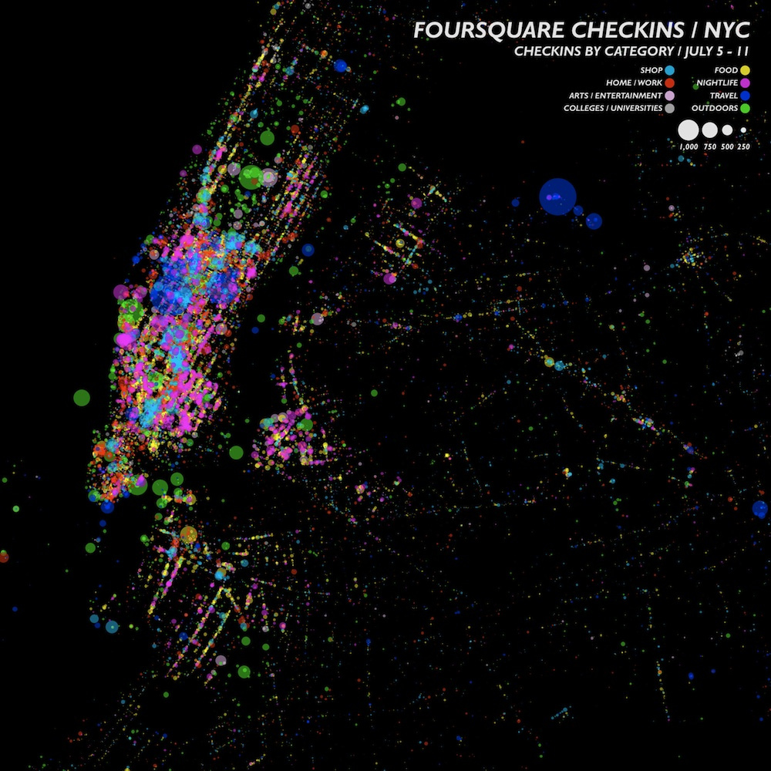
HOW ARE EVERYDAY
SPATIALITIES MEDIATED
BY DIGITALITY?
Agnieszka Leszczynski • University of Birmingham • DM7 2015
Image : Spatial Information Design Lab, 2012, CC-BY-NC-ND 2.0. ‘Foursquare Checkins – NYC,’ http://www.flickr.com/photos/spatialinformationdesignlab/7706439454/; Accessed 23 March 2014

Slide 2
the enmeshing of physical spaces & codified content

Slide 3
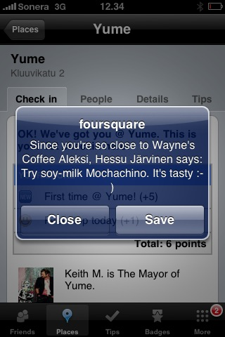
Image : Tuija Aalto, 2012, CC-BY-NC-ND 2.0. ‘Foursquare vinkki,’ http://www.flickr.com/photos/tuija/4457255211; Accessed 23 March 2014

Slide 4
digital-material embodiment of enactments of space & place

Slide 5
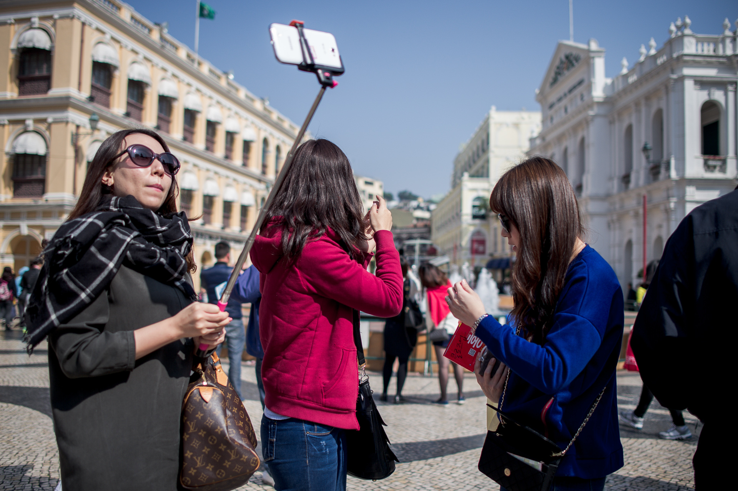
Image : Kevin Dharmawan, 2015, CC-BY-NC-ND 2.0. ‘Selfies @Macau,’ https://www.flickr.com/photos/k2-d2/16129500674; Accessed 23 March 2014

Slide 6
spatialization of interfaces, devices, & content

Slide 7
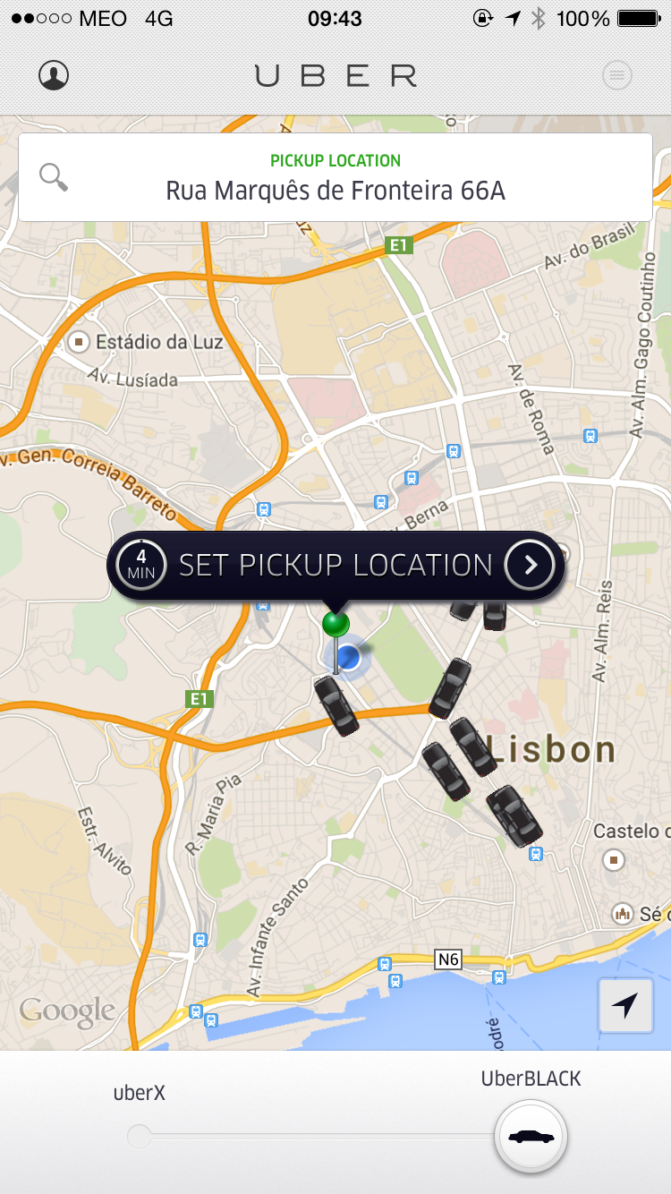
Image : Gustavo da Cunha Pimenta, 2014, CC BY-SA 2.0. ‘Uber,’ https://www.flickr.com/photos/guspim/16126210441/in/photolist-qwUDcf-qz83XS-qz23x4-qwUDqG-qz83kE-qhCcpw; Accessed 23 March 2014

Slide 8
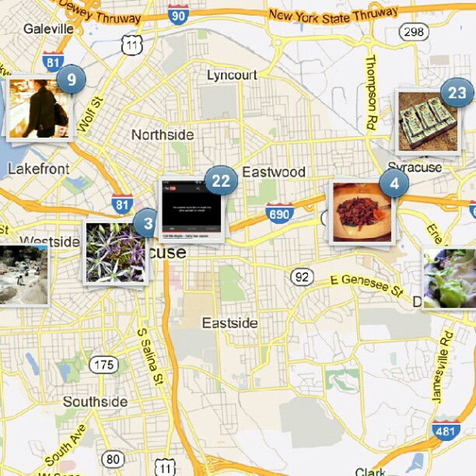
Image : Dino Husejnovic, 2012, CC BY 2.0. ‘Loving the new instagram maps,’ https://www.flickr.com/photos/68124224@N08/7797455636; Accessed 23 March 2014

Slide 9
MEDIATION

Slide 10
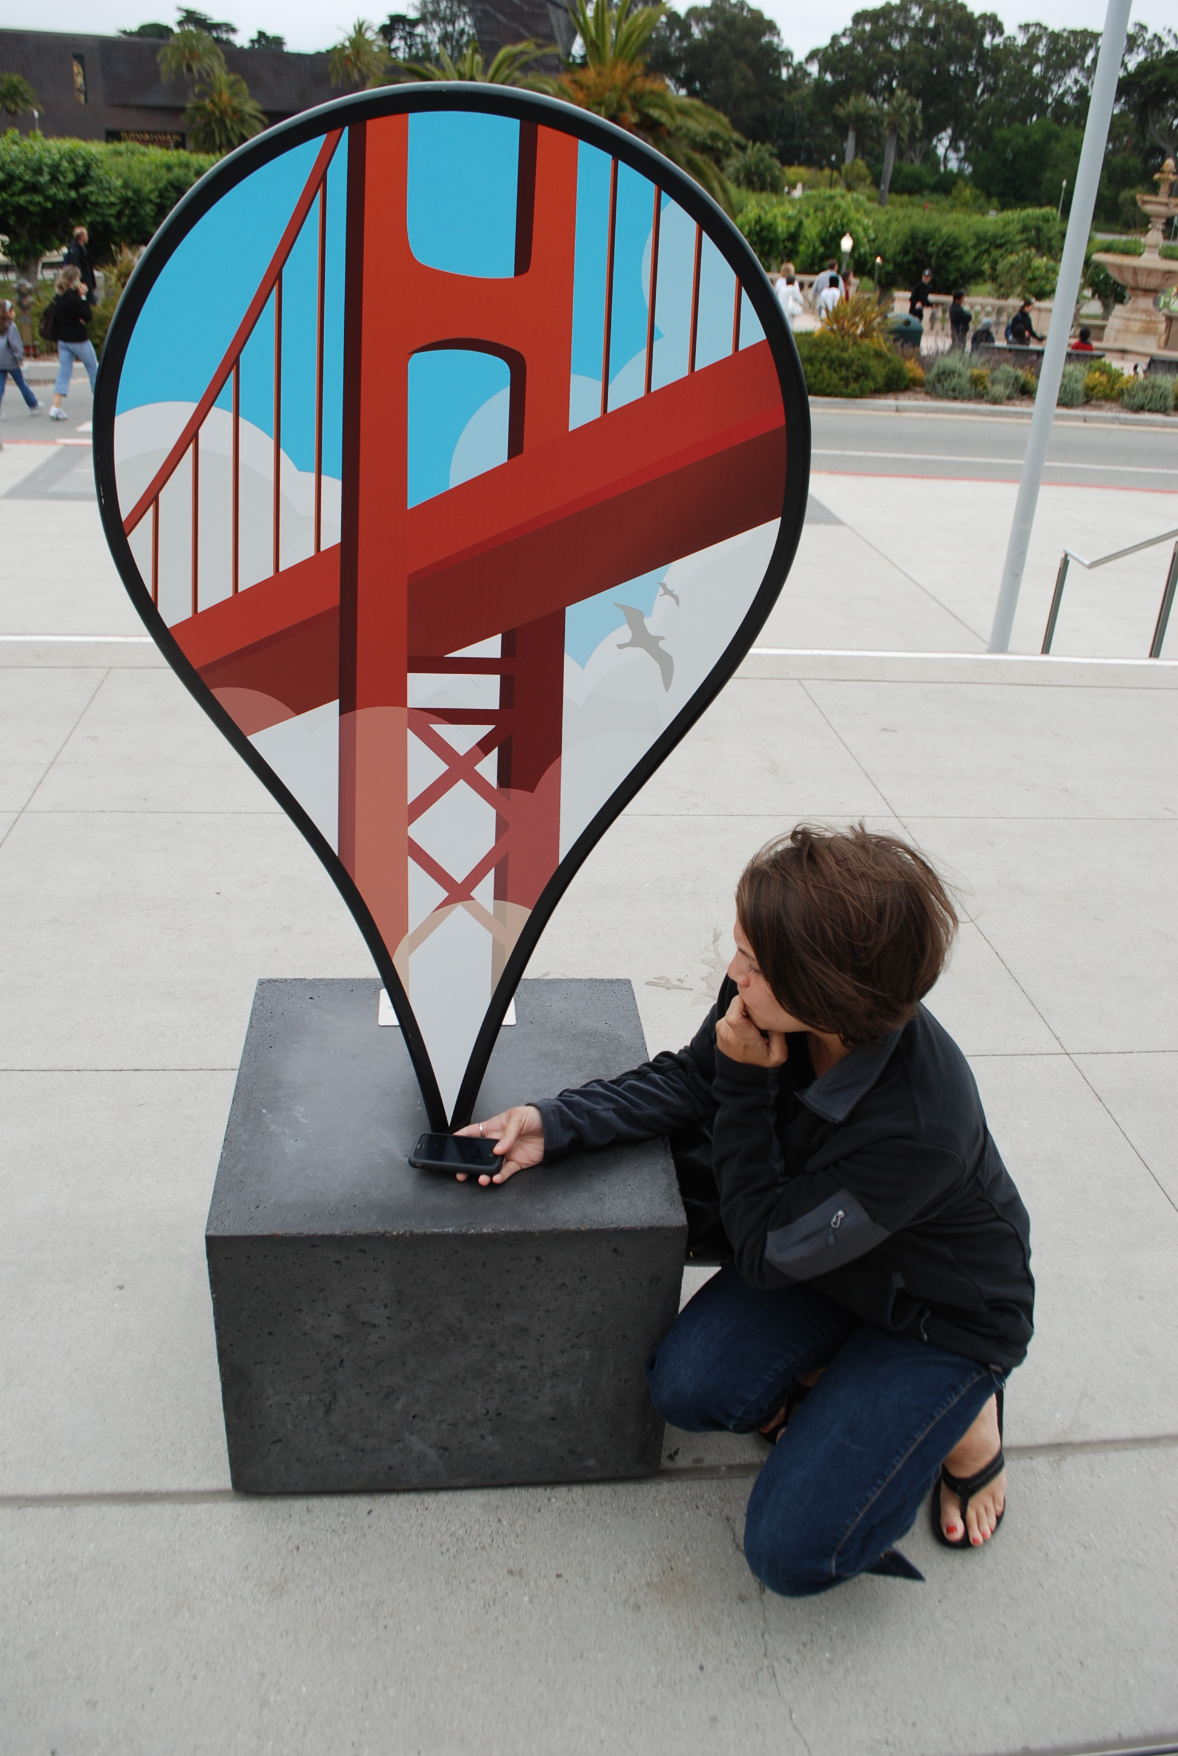
Image : Ian Usher, 2009, CC BY-NC-SA 2.0. ‘Really big Google Maps placemark,’ https://www.flickr.com/photos/ush/3758790990/; Accessed 23 March 2014

